Slide 1
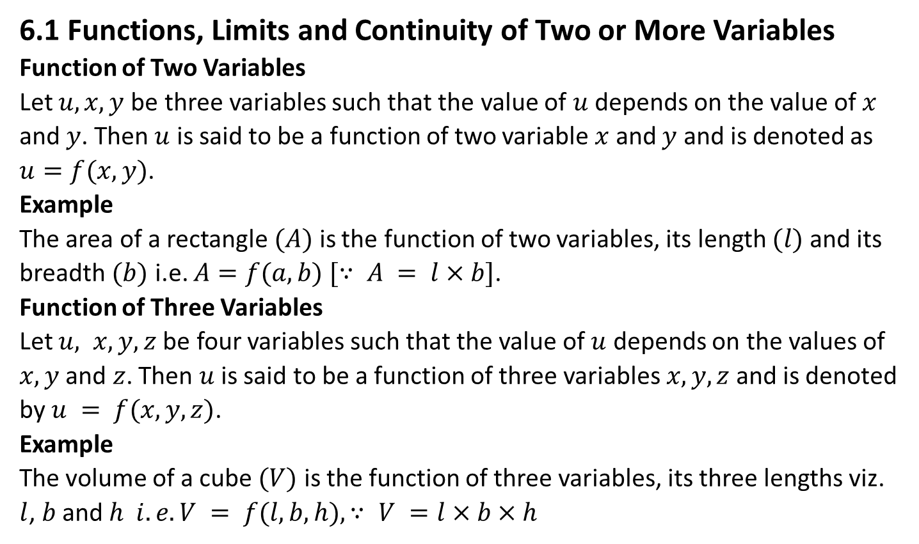
Unit-10 Partial Derivatives and Multiple Integrals
6.1 Functions, Limits and Continuity of Two or More Variables
Function of Two Variables
Let $u, x, y$be three variables such that the value of $u$ depends on the value of $x$ and $y$. Then $u$ is said to be a function of two variable $x$ and $y$ and is denoted as $u=f(x,y)$.
Example
The area of a rectangle $(A)$ is the function of two variables, its length $(l)$ and its breadth $(b)$ i.e. $A=f(a,b) [∵ A = l×b]$.
Function of Three Variables
Let $u, x, y, z$be four variables such that the value of $u$ depends on the values of $x, y$ and $z$. Then $u$ is said to be a function of three variables $x, y, z$and is denoted by $u = f(x,y,z)$.
Example
The volume of a cube $(V)$ is the function of three variables, its three lengths viz. $l$, $b$ and $h i.e. V = f(l,b,h), ∵ V =l×b×h$

Slide 2
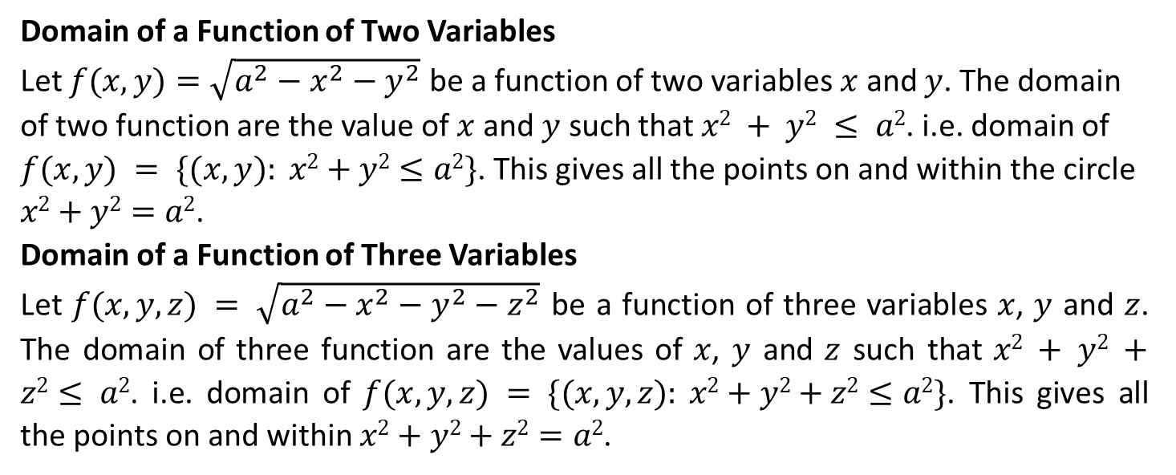
Domain of a Function of Two Variables
Let $f(x,y)=\sqrt{a^{2}−x^{2}−y^{2}}$ be a function of two variables $x$ and $y$. The domain of two function are the value of $x$ and $y$ such that $x2 + y2 ≤ a2$. i.e. domain of $f(x,y) = \{(x,y): x2+y2≤a2\}$. This gives all the points on and within the circle $x2+y2=a2$.
Domain of a Function of Three Variables
Let $f(x,y,z) = \sqrt{a^{2}−x^{2}−y^{2}−z^{2}}$ be a function of three variables $x$, $y$ and $z$. The domain of three function are the values of $x$, $y$ and $z$ such that $x2 + y2 +z2≤ a2$. i.e. domain of $f(x,y,z) = \{(x,y,z): x2+y2+z2≤a2\}$. This gives all the points on and within $x2+y2+z2=a2$.

Slide 3
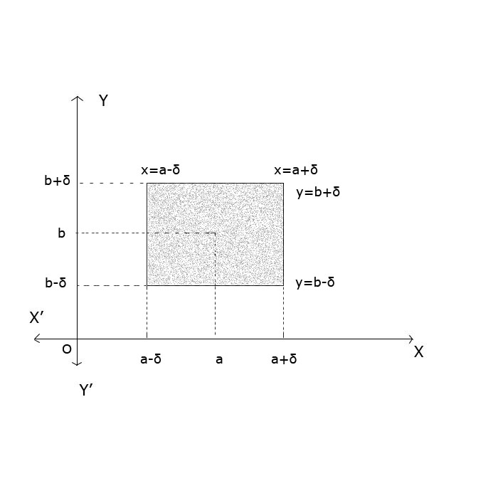
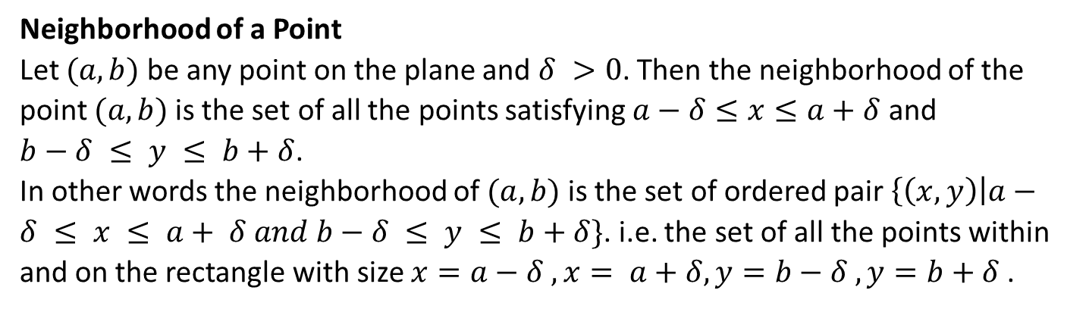
Neighborhood of a Point
Let $(a,b)$ be any point on the plane and $δ >0$. Then the neighborhood of the point $(a,b)$ is the set of all the points satisfying $a−δ≤x≤a+δ$ and $b−δ ≤ y ≤ b+δ$.
In other words the neighborhood of $(a,b)$ is the set of ordered pair $\left\{\left(x,y\right)\right|a−δ ≤ x ≤ a+ δ and b−δ ≤ y ≤ b+δ\}$. i.e. the set of all the points within and on the rectangle with size $x=a−δ , x= a+δ, y=b−δ , y=b+δ$.

Slide 4
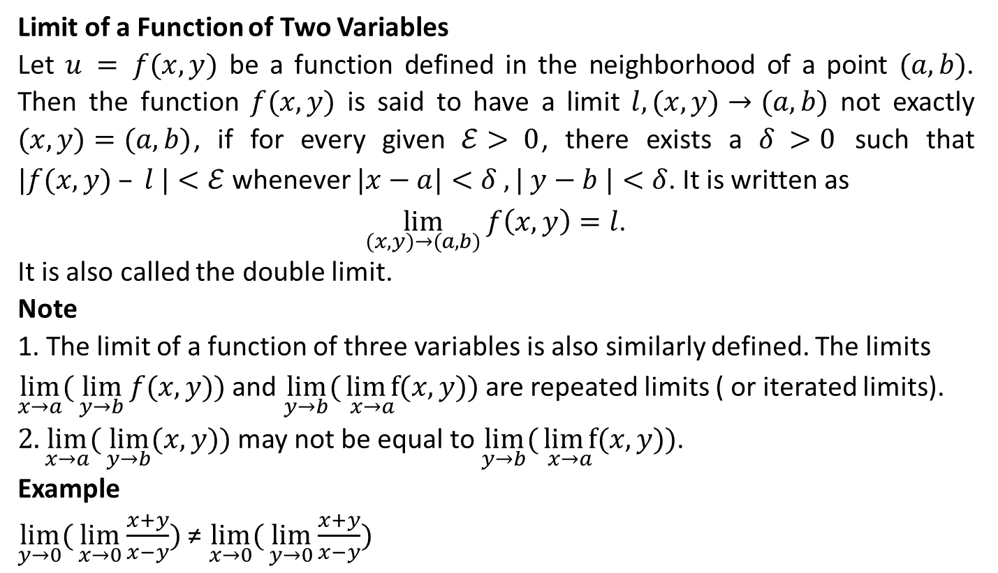
Limit of a Function of Two Variables
Let $u = f(x,y)$ be a function defined in the neighborhood of a point $(a,b)$. Then the function $f(x,y)$ is said to have a limit $l, (x,y)→(a,b)$ not exactly $(x,y)=(a,b)$, if for every given $ℰ> 0$, there exists a $δ >0$ such that $|f(x,y) – l |<ℰ$ whenever $|x−a|<δ , | y−b |<δ$. It is written as
$\lim_{(x,y)→(a,b)}{f\left(x,y\right)=l}$.
It is also called the double limit.
Note
1. The limit of a function of three variables is also similarly defined. The limits $\lim_{x→a}{(}\lim_{y→b}{f(x,y)})$ and $\lim_{y→b}{(}\underset{x→a}{lim⁡f}{(x,y)})$ are repeated limits ( or iterated limits).
$2.\lim_{x→a}{(}\lim_{y→b}{(x,y)})$ may not be equal to $\lim_{y→b}{(}\underset{x→a}{lim⁡f}{(x,y)})$.
Example
$\lim_{y→0}{(}\underset{x→0}{lim⁡}{\frac{x+y}{x−y}})$ ≠ $\lim_{x→0}{(}\lim_{y→0}{\frac{x+y}{x−y}})$

Slide 5
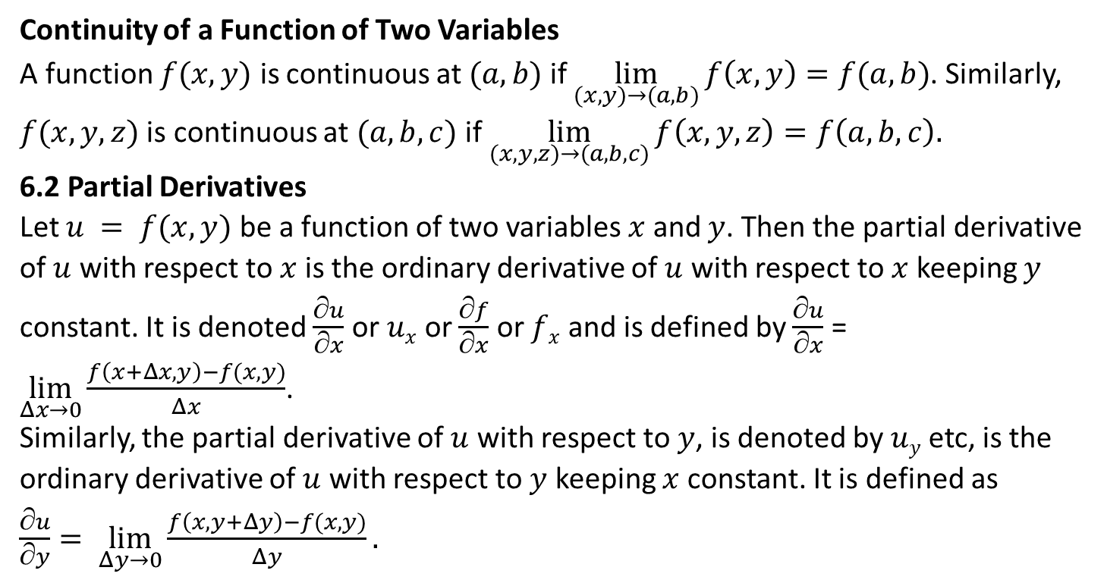
Continuity of a Function of Two Variables
A function $f(x,y)$ is continuous at $(a,b)$ if $\lim_{(x,y)→(a,b)}{f\left(x,y\right)=f(a,b)}$. Similarly, $f(x,y,z)$ is continuous at $(a,b,c)$ if $\lim_{(x,y,z)→(a,b,c)}{f\left(x,y,z\right)=f\left(a,b,c\right).}$
6.2 Partial Derivatives
Let $u = f(x,y)$ be a function of two variables $x$ and $y$. Then the partial derivative of $u$ with respect to $x$ is the ordinary derivative of $u$ with respect to $x$ keeping $y$ constant. It is denoted $\frac{∂u}{∂x}$ or $ux$ or $\frac{∂f}{∂x}$ or $fx$­ and is defined by $\frac{∂u}{∂x}$ = $\lim_{Δx→0}{\frac{f\left(x+Δx,y\right)−f(x,y)}{Δx}}$.
Similarly, the partial derivative of $u$ with respect to $y$, is denoted by $uy$ etc, is the ordinary derivative of $u$ with respect to $y$ keeping $x$ constant. It is defined as $\frac{∂u}{∂y}= \lim_{Δy→0}{\frac{f\left(x,y+Δy\right)−f(x,y)}{Δy}.}$

Slide 6
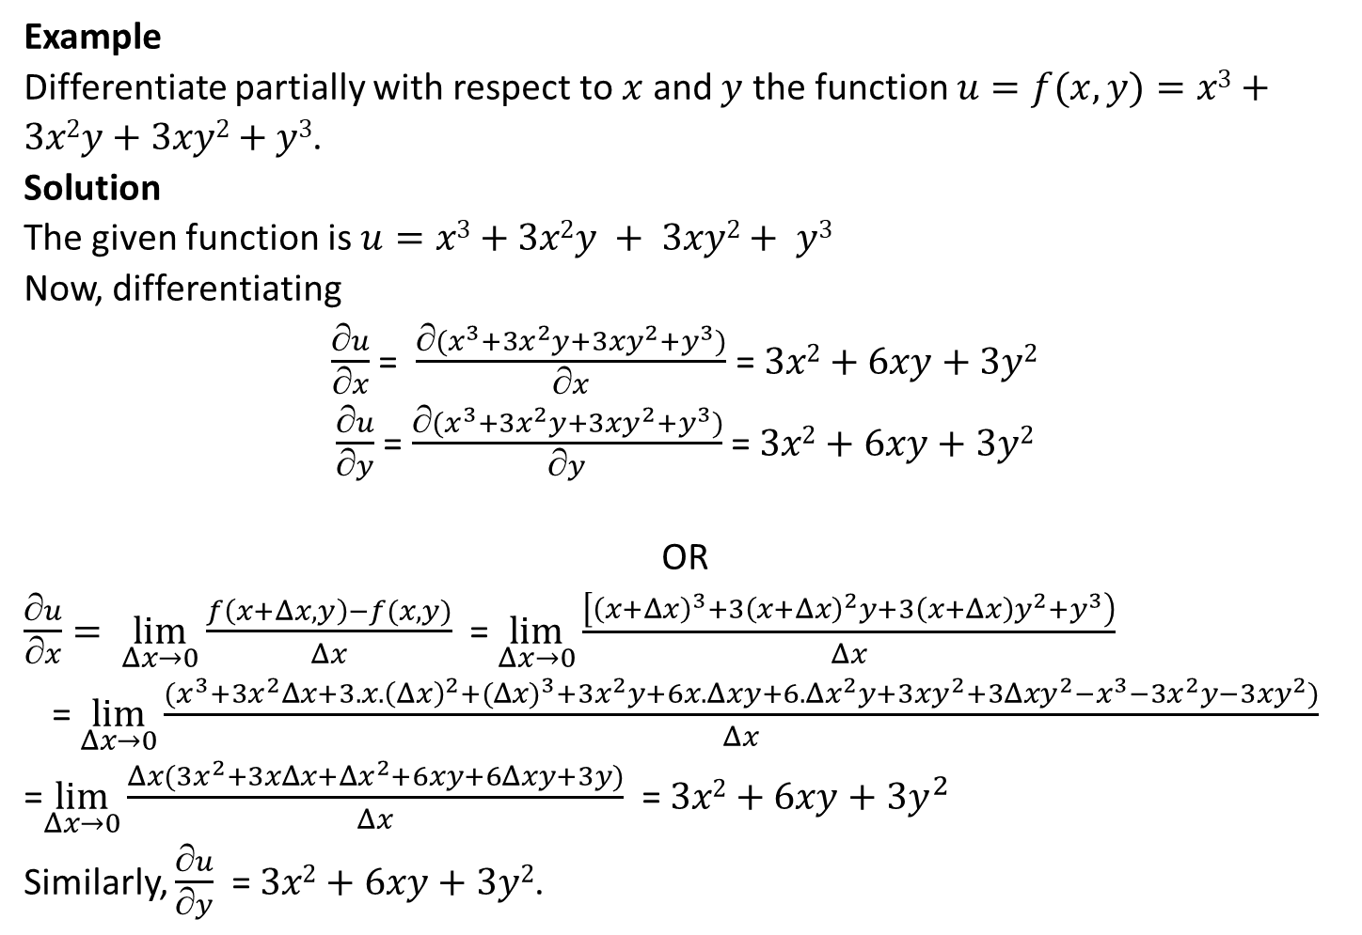
Example
Differentiate partially with respect to $x$ and $y$ the function $u=f(x,y)=x3+3x2y+3xy2+y3$.
Solution
The given function is $u=x3+3x2y + 3xy2+ y3$
Now, differentiating
$\frac{∂u}{∂x}$ = $\frac{∂(x^{3}+3x^{2}y+3xy^{2}+y^{3})}{∂x}$ = $3x2+6xy+3y2$
$\frac{∂u}{∂y}$ = $\frac{∂(x^{3}+3x^{2}y+3xy^{2}+y^{3})}{∂y}$ = $3x2+6xy+3y2$
OR
$\frac{∂u}{∂x}= \lim_{Δx→0}{\frac{f\left(x+Δx,y\right)−f(x,y)}{Δx}}$ = $\lim_{Δx→0}{\frac{\left[{\left(x+Δx\right)}^{3}+3{\left(x+Δx\right)}^{2}y+3\left(x+Δx\right)y^{2}+y^{3}\right)}{Δx}}$
= $\lim_{Δx→0}{\frac{(x^{3}+3x^{2}Δx+3.x.{\left(Δx\right)}^{2}+({Δx)}^{3}+3x^{2}y+6x.Δxy+6.Δx^{2}y+3xy^{2}+3Δxy^{2}−x^{3}−3x^{2}y−3xy^{2})}{Δx}}$
=$\lim_{Δx→0}{\frac{Δx(3x^{2}+3xΔx+Δx^{2}+6xy+6Δxy+3y)}{Δx}}$ = $3x2+6xy+3y^{2}$ Similarly, $\frac{∂u}{∂y}$ = $3x2+6xy+3y2$.

Slide 7
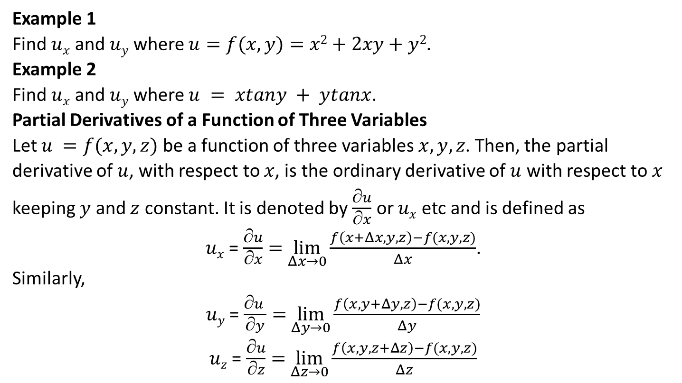
Example 1
Find $ux$ and $uy$ where $u=f(x,y)=x2+2xy+y2$.
Example 2
Find $ux$ and $uy$ where $u = xtany + ytanx$.
Partial Derivatives of a Function of Three Variables
Let $u =f(x,y,z)$ be a function of three variables $x,y,z$. Then, the partial derivative of $u$, with respect to $x$, is the ordinary derivative of $u$ with respect to $x$ keeping $y$ and $z$ constant. It is denoted by $\frac{∂u}{∂x}$ or $ux$ etc and is defined as
$ux$ = $\frac{∂u}{∂x}=$ $\lim_{Δx→0}{\frac{f\left(x+Δx,y,z\right)−f(x,y,z)}{Δx}}$.
Similarly,
$uy$ = $\frac{∂u }{∂y}=$ $\lim_{Δy→0}{\frac{f\left(x, y+Δy,z\right)−f(x,y,z)}{Δy}}$
$uz$ = $\frac{∂u}{∂z}=$ $\lim_{Δz→0}{\frac{f\left(x,y,z+Δz\right)−f(x,y,z)}{Δz}}$

Slide 8
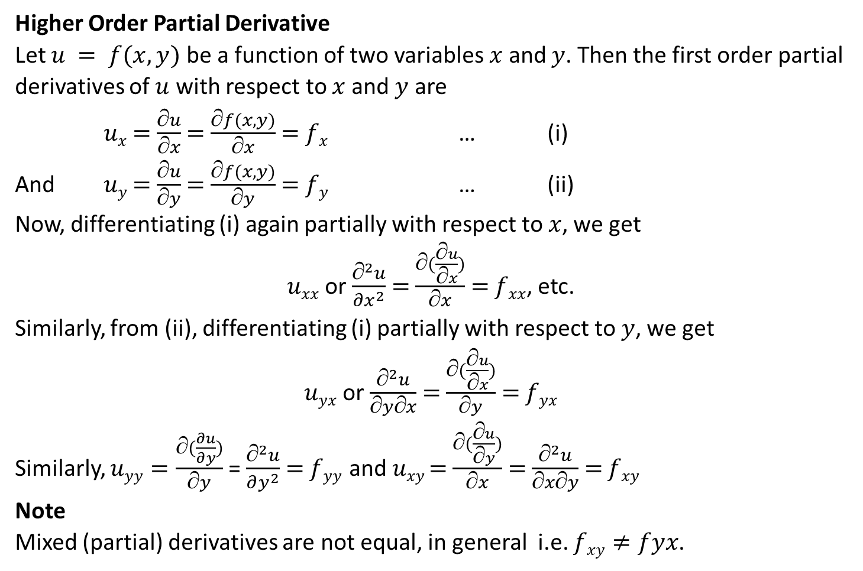
Higher Order Partial Derivative
Let $u = f(x,y)$ be a function of two variables $x$ and $y$. Then the first order partial derivatives of $u$ with respect to $x$ and $y$ are
$ux$ $=$ $\frac{∂u}{∂x}$ $=$ $\frac{∂f(x,y)}{∂x}$ $=$ $fx$ … (i)
And $uy$ $=$ $\frac{∂u}{∂y}$ $=$ $\frac{∂f(x,y)}{∂y}$ $=$ $f­­y$ … (ii)
Now, differentiating (i) again partially with respect to $x$, we get
$uxx$ or $\frac{∂^{2}u}{{∂x}^{2}}$ $=$ $\frac{∂(\frac{∂u}{∂x})}{∂x}$ $=$ $fxx$, etc.
Similarly, from (ii), differentiating (i) partially with respect to $y$, we get
$uyx$ or $\frac{∂^{2}u}{∂y∂x}$ $=$ $\frac{∂(\frac{∂u}{∂x})}{∂y}$ $=$ $fyx$
Similarly, $uyy=\frac{∂(\frac{∂u}{∂y})}{∂y}$ = $\frac{∂^{2}u}{∂y^{2}}$ $=$ $fyy$ and $uxy$ $=$ $\frac{∂(\frac{∂u}{∂y})}{∂x}$ $=$ $\frac{∂^{2}u}{∂x∂y}$ $=$ $f­xy$
Note
Mixed (partial) derivatives are not equal, in general i.e. $fxy≠fyx$.

Slide 9
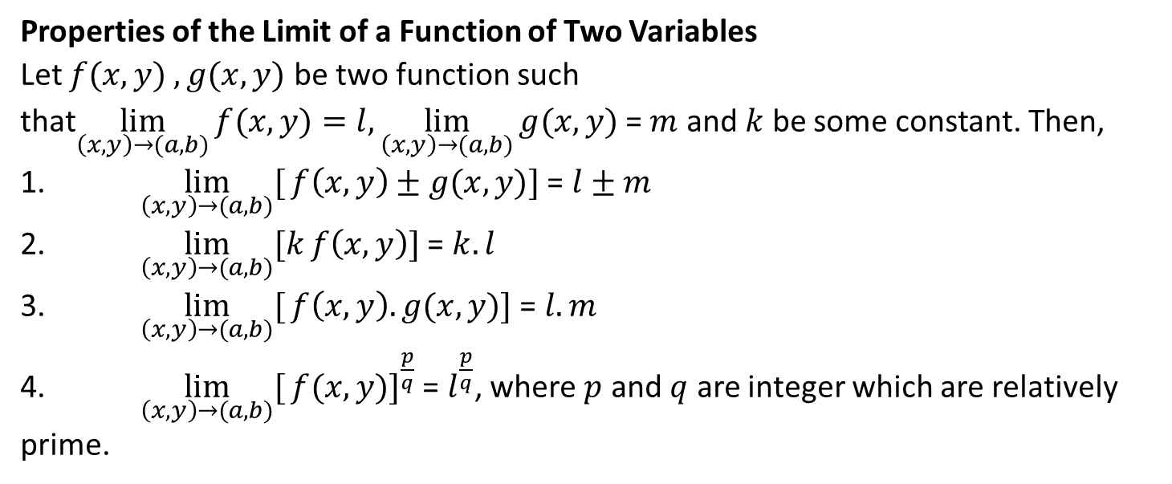
Properties of the Limit of a Function of Two Variables
Let $f(x,y) , g(x,y)$ be two function such that$\lim_{\left(x,y\right)→(a,b)}{f(x,y)}=l,\lim_{\left(x,y\right)→(a,b)}{g(x,y)}$ = $m$ and $k$ be some constant. Then,
1. $\lim_{\left(x,y\right)→(a,b)}[{f\left(x,y\right)±g(x,y)]}$ = $l±m$
2. $\lim_{\left(x,y\right)→(a,b)}[k{f\left(x,y\right)]}$ = $k.l$
3. $\lim_{\left(x,y\right)→(a,b)}[{f\left(x,y\right).g(x,y)]}$ = $l.m$
4. $\lim_{\left(x,y\right)→(a,b)}[{{f(x,y)]}^{\frac{p}{q}}}$ = $l^{\frac{p}{q}}$, where $p$ and $q$ are integer which are relatively prime.

Slide 10
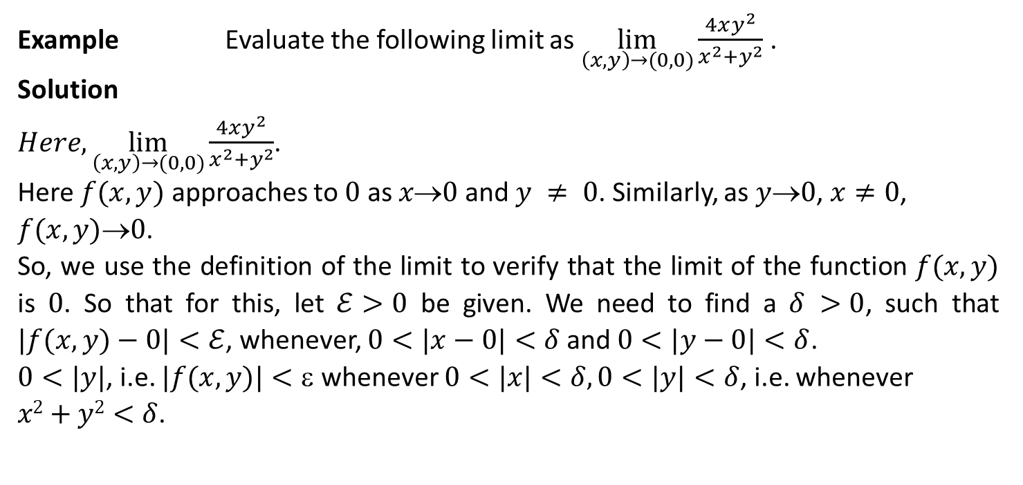
Example Evaluate the following limit as $\lim_{\left(x,y\right)→(0,0)}{\frac{4xy^{2}}{x^{2}+y^{2}}}$ .
Solution
$Here, \lim_{\left(x,y\right)→(0,0)}{\frac{4xy^{2}}{x^{2}+y^{2}}}$.
Here $f(x,y)$ approaches to $0$ as $x0$ and $y ≠ 0$. Similarly, as $y0$, $x≠0$, $f(x,y)0$.
So, we use the definition of the limit to verify that the limit of the function $f(x,y)$ is $0$. So that for this, let $ℰ>0$ be given. We need to find a $δ >0$, such that $|f(x,y)−0|<ℰ$, whenever, $0<|x−0|<δ$and $0<|y−0|<δ$.
$0<|y|$, i.e. $|f(x,y)|<$ whenever $0<|x|<δ, 0<|y|<δ$, i.e. whenever $x2+y2<δ$.

Slide 11
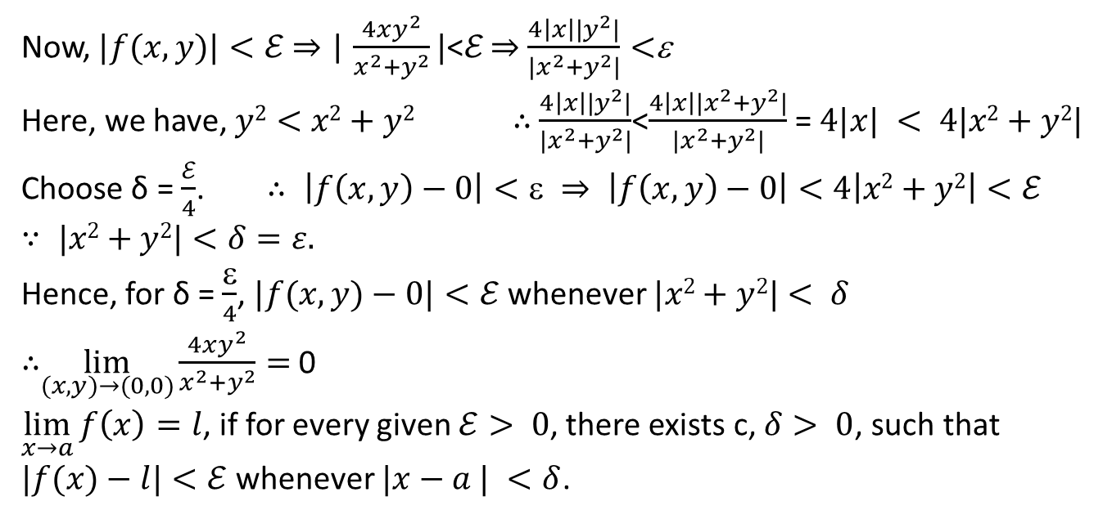
Now, $|f(x,y)|<ℰ$⇒ | $\frac{4xy^{2}}{x^{2}+y^{2}}|$<ℰ ⇒ $\frac{4\left|x\right||y^{2}|}{|x^{2}+y^{2}|}<$ε
Here, we have, $y2<x2+y2$ ∴ $\frac{4\left|x\right||y^{2}|}{|x^{2}+y^{2}|}$<$\frac{4\left|x\right||x^{2}+y^{2}|}{|x^{2}+y^{2}|}$ = $4|x| < 4|x2+y2|$
Choose δ = $\frac{ℰ}{4}$. $∴ \left|f\left(x,y\right)−0\right|<ε ⇒ \left|f\left(x,y\right)−0\right|<4\left|x2+y2\right|<ℰ$
$∵ |x2+y2|<δ=ε$.
Hence, for δ = $\frac{ε}{4}$, $|f(x,y)−0|<ℰ$whenever $|x2+y2|< δ$
∴$\lim_{(x,y)→(0,0)}{\frac{4xy^{2}}{x^{2}+y^{2}}}=$0
$\lim_{x→a}{f\left(x\right)=l}$, if for every given $ℰ> 0$, there exists c, $δ> 0$, such that $|f(x)−l|<ℰ$whenever $|x−a | <δ$.

Slide 12
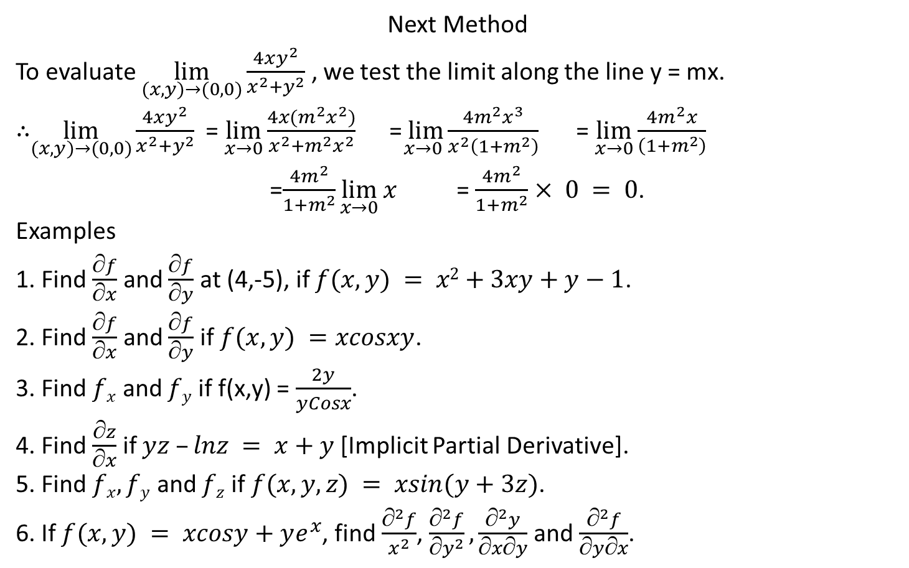
Next Method
To evaluate $\lim_{(x,y)→(0,0)}{\frac{4xy^{2}}{x^{2}+y^{2}}}$ , we test the limit along the line y = mx.
∴$\lim_{(x,y)→(0,0)}{\frac{4xy^{2}}{x^{2}+y^{2}}}$ = $\lim_{x→0}{\frac{4x(m^{2}x^{2})}{x^{2}+m^{2}x^{2}}}$ =$\lim_{x→0}{\frac{4m^{2}x^{3}}{\begin{aligned}x^{2}\left(1+m^{2}\right)\end{aligned}}}$ = $\lim_{x→0}{\frac{4m^{2}x}{\left(1+m^{2}\right)}}$
=$\frac{4m^{2}}{1+m^{2}}\lim_{x→0}{x}$ = $\frac{4m^{2}}{1+m^{2}}$ $× 0 = 0$.
Examples
1. Find $\frac{∂f}{∂x}$ and $\frac{∂f}{∂y}$ at (4,-5), if $f(x,y) = x2+3xy+y−1$.
2. Find $\frac{∂f}{∂x}$ and $\frac{∂f}{∂y}$ if $f(x,y) =xcosxy$.
3. Find $fx$ and $fy$ if f(x,y) = $\frac{2y}{yCosx}$.
4. Find $\frac{∂z}{∂x}$ if $yz –lnz = x+y$[Implicit Partial Derivative].
5. Find $fx, fy$ and $fz$ if $f(x,y,z) = xsin(y+3z)$.
6. If $f(x,y) = xcosy+ye^{x}$, find $\frac{∂^{2}f}{x^{2}}$, $\frac{^{2}f}{{y}^{2}}, \frac{^{2}y}{xy}$ and $\frac{∂^{2}f}{∂y∂x}$.

Slide 13
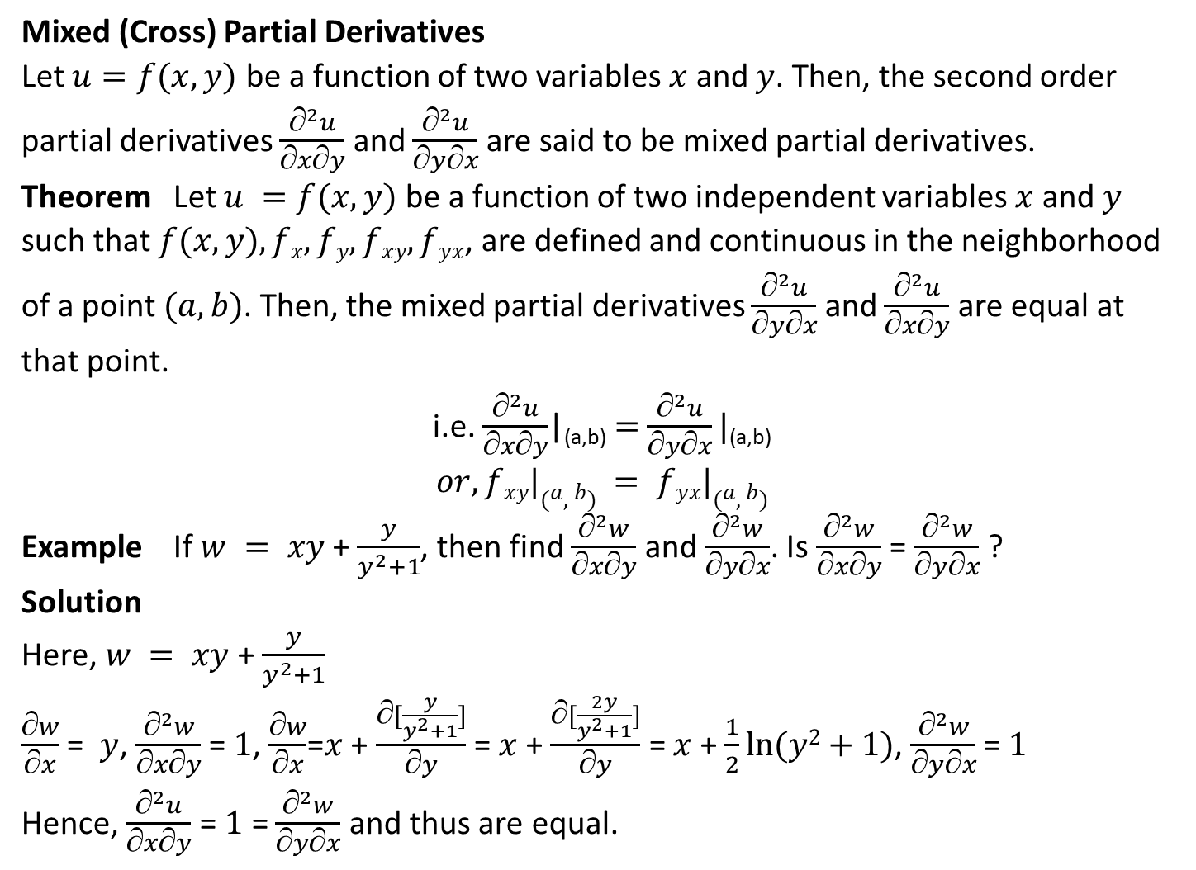
Mixed (Cross) Partial Derivatives
Let $u=f(x,y)$ be a function of two variables $x$ and $y$. Then, the second order partial derivatives $\frac{∂^{2}u}{∂x∂y}$ and $\frac{∂^{2}u}{∂y∂x}$ are said to be mixed partial derivatives.
Theorem Let $u =f(x,y)$ be a function of two independent variables $x$and $y$ such that $f(x,y), fx, fy, fxy, fyx$, are defined and continuous in the neighborhood of a point $(a,b)$. Then, the mixed partial derivatives $\frac{∂^{2}u}{∂y∂x}$ and $\frac{∂^{2}u}{∂x∂y}$ are equal at that point.
i.e. $\frac{∂^{2}u}{∂x∂y}$|_{(a,b)} $=$ $\frac{∂^{2}u}{∂y∂x}|$_{(a,b)}
$$or, fxy|(a,b) = fyx|(a,b)$$
Example If $w = xy$+ $\frac{y}{y^{2}+1}$, then find $\frac{∂^{2}w}{∂x∂y}$ and $\frac{∂^{2}w}{∂y∂x}$. Is $\frac{∂^{2}w}{∂x∂y}$ = $\frac{∂^{2}w}{∂y∂x}$ ?
Solution
Here, $w = xy$+ $\frac{y}{y^{2}+1}$
$\frac{∂w}{∂x}$ = $y$, $\frac{∂^{2}w}{∂x∂y}$ = $1$, $\frac{∂w}{∂x}$=$x$ + $\frac{∂[\frac{y}{y^{2}+1}]}{∂y}$ = $x$ + $\frac{∂[\frac{2y}{y^{2}+1}]}{∂y}$ = $x$ + $\frac{1}{2}ln⁡(y2+1)$, $\frac{∂^{2}w}{∂y∂x}$ = $1$
Hence, $\frac{∂^{2}u}{∂x∂y}$ = $1$ = $\frac{∂^{2}w}{∂y∂x}$ and thus are equal.

Slide 14
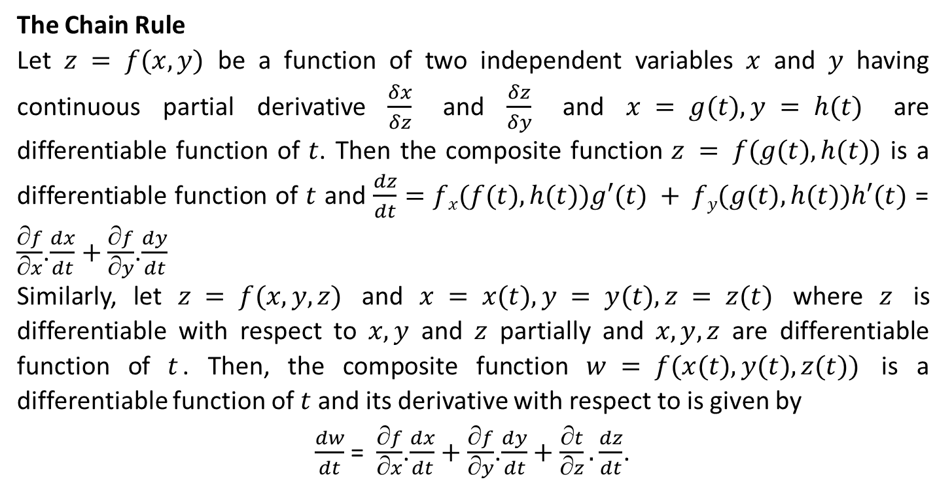
The Chain Rule
Let $z = f(x,y)$ be a function of two independent variables $x$ and $y$ having continuous partial derivative $\frac{δx}{δz}$ and $\frac{δz}{δy}$ and $x = g(t), y = h(t)$ are differentiable function of $t$. Then the composite function $z = f(g(t),h(t))$ is a differentiable function of $t$ and $\frac{dz}{dt}$ $=$ $fx(f(t),h(t))g′(t) + fy(g(t),h(t))h′(t)$ = $\frac{∂f}{∂x}$.$\frac{dx}{dt}+\frac{∂f}{∂y}$.$\frac{dy}{dt}$
Similarly, let $z = f(x,y,z)$ and $x = x(t), y = y(t), z = z(t)$ where $z$ is differentiable with respect to $x, y$ and $z$ partially and $x,y,z$ are differentiable function of $t$. Then, the composite function $w = f(x(t),y(t),z(t))$ is a differentiable function of $t$ and its derivative with respect to is given by
$\frac{dw}{dt}$ = $\frac{∂f}{∂x}$.$\frac{dx}{dt}$ $+$ $\frac{∂f}{∂y}$.$\frac{dy}{dt}+\frac{∂t}{∂z}.\frac{dz}{dt}$.

Slide 15
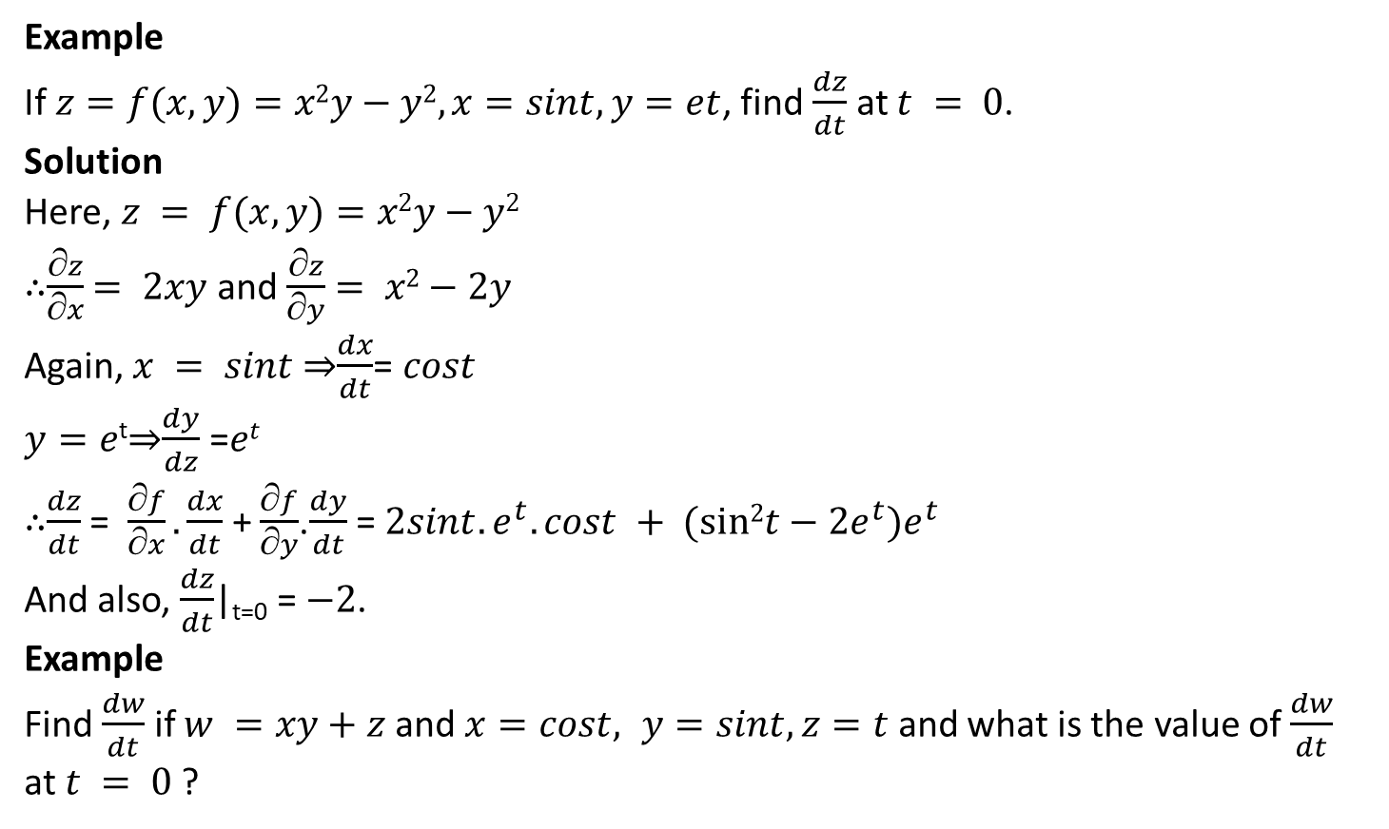
Example
If $z=f(x,y)=x2y−y2, x=sint, y=et$, find $\frac{dz}{dt}$ at $t = 0$.
Solution
Here, $z = f(x,y)=x2y−y2$
∴$\frac{∂z}{∂x}$ $= 2xy$ and $\frac{∂z}{∂y}$ $= x2−2y$
Again, $x = sint$⇒$\frac{dx}{dt}$= $cost$
$y=e$^{t}⇒$\frac{dy}{dz}$ =$et$
∴$\frac{dz}{dt}$ = $\frac{∂f}{∂x}.\frac{dx}{dt}$ + $\frac{∂f}{∂y}$.$\frac{dy}{dt}$ = $2sint.e^{t}. cost + (sin2t−2e^{t})e^{t}$
And also, $\frac{dz}{dt}$|_{t=0} = $−2$.
Example
Find $\frac{dw}{dt}$ if $w =xy+z$ and $x=cost, y=sint, z=t$ and what is the value of $\frac{dw}{dt}$ at $t = 0$?

Slide 16
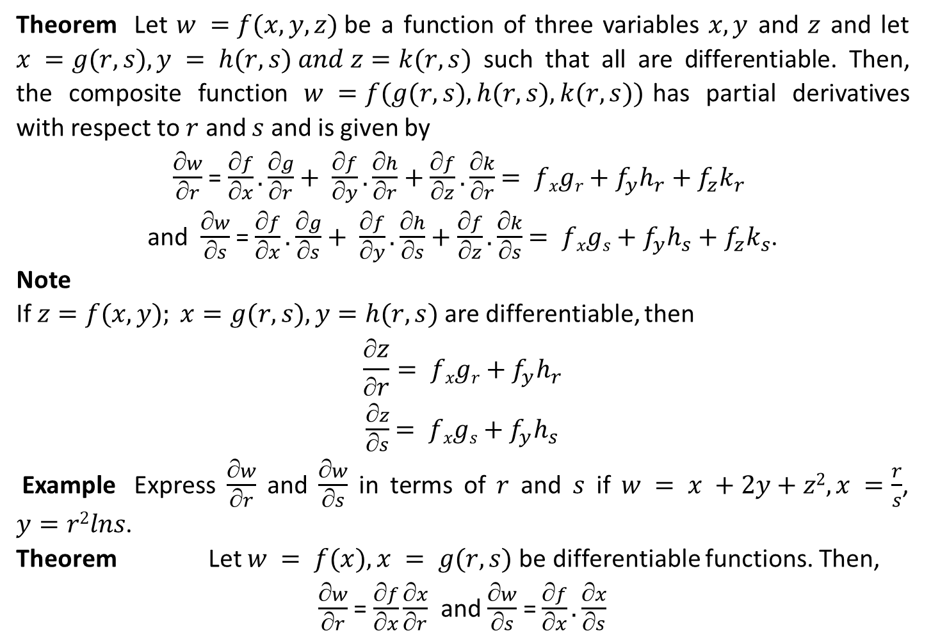
Theorem Let $w =f(x,y,z)$be a function of three variables $x, y$ and $z$ and let $x =g(r,s), y = h(r,s) and z=k(r,s)$ such that all are differentiable. Then, the composite function $w =f(g(r,s),h(r,s),k(r,s))$has partial derivatives with respect to $r$ and $s$ and is given by
$\frac{∂w}{∂r}$ = $\frac{f}{x}.\frac{g}{r}+ \frac{f}{y}.\frac{h}{r}+\frac{f}{z}.\frac{k}{r}$ $= fxgr+f_{y}h_{r}+f_{z}k_{r}$
and $\frac{∂w}{∂s}$ = $\frac{f}{x}.\frac{g}{s}+ \frac{f}{y}.\frac{h}{s}+\frac{f}{z}.\frac{k}{s}$ $= fxgs+f_{y}h_{s}+f_{z}k_{s}$.
Note
If $z=f(x,y); x=g(r,s), y=h(r,s)$are differentiable, then
$$\frac{∂z}{∂r}= fxgr+f_{y}h_{r}$$
$\frac{∂z}{∂s}$ $= fxgs+f_{y}h_{s}$
Example Express $\frac{∂w}{∂r}$ and $\frac{∂w}{∂s}$ in terms of $r$ and $s$ if $w = x +2y+z2, x =\frac{r}{s}$, $y=r2lns$.
Theorem Let $w = f(x), x = g(r,s)$be differentiable functions. Then,
$\frac{∂w}{∂r}$ = $\frac{∂f}{∂x}\frac{∂x}{∂r}$ and $\frac{∂w}{∂s}$ = $\frac{∂f}{∂x}. \frac{∂x}{∂s}$

Slide 17
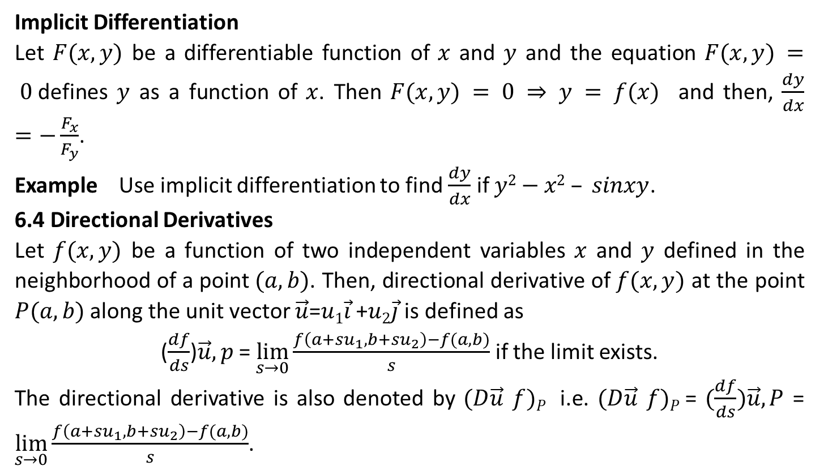
Implicit Differentiation
Let $F(x,y)$ be a differentiable function of $x$ and $y$ and the equation $F(x,y) = 0$defines $y$ as a function of $x$. Then $F(x,y) = 0 ⇒ y = f(x)$ and then, $\frac{dy}{dx}$ $=−\frac{F_{x}}{F_{y}}$.
Example Use implicit differentiation to find $\frac{dy}{dx}$ if $y2−x2 – sinxy$.
6.4 Directional Derivatives
Let $f(x,y)$ be a function of two independent variables $x$ and $y$ defined in the neighborhood of a point $(a,b)$. Then, directional derivative of $f(x,y)$ at the point $P(a,b)$ along the unit vector $\vec{u}$=$u1\vec{i}$ +$u2\vec{j}$ is defined as
($\frac{df}{ds}$)$\vec{u},p$ = $\lim_{s→0}{\frac{f\left(a+su_{1},b+su_{2}\right)−f(a,b)}{s}}$ if the limit exists.
The directional derivative is also denoted by $(D\vec{u}$ $f)P$ i.e. $(D\vec{u}$ $f)P$ = $(\frac{df}{ds})\vec{u},P$ = $\lim_{s→0}{\frac{f\left(a+su_{1},b+su_{2}\right)−f(a,b)}{s}}$.

Slide 18
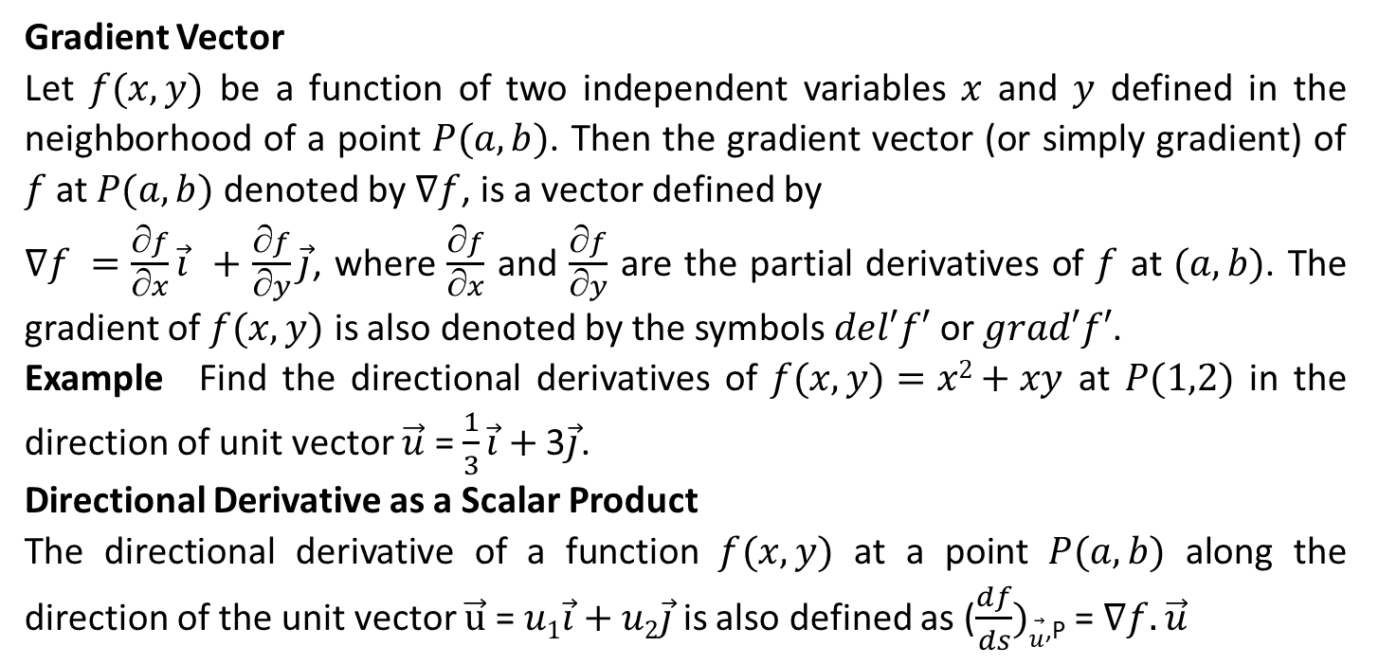
Gradient Vector
Let $f(x,y)$ be a function of two independent variables $x$ and $y$ defined in the neighborhood of a point $P(a,b)$. Then the gradient vector (or simply gradient) of $f$ at $P(a,b)$ denoted by $∇f$, is a vector defined by
$∇f =$ $\frac{∂f}{∂x}\vec{i}$ $+$ $\frac{∂f}{∂y}\vec{j}$, where $\frac{∂f}{∂x}$ and $\frac{∂f}{∂y}$ are the partial derivatives of $f$ at $(a,b)$. The gradient of $f(x,y)$ is also denoted by the symbols $del′f′$ or $grad′f′$.
Example Find the directional derivatives of $f(x,y)=x2+xy$ at $P(1,2)$ in the direction of unit vector $\vec{u}$ = $\frac{1}{3}\vec{i}$ $+$ 3$\vec{j}$.
Directional Derivative as a Scalar Product
The directional derivative of a function $f(x,y)$ at a point $P(a,b)$ along the direction of the unit vector $\vec{u}$ = $u1\vec{i}$ $+$ $u2\vec{j}$ is also defined as ($\frac{df}{ds})\vec{u}$_{,P} = $∇f.\vec{u}$

Slide 19
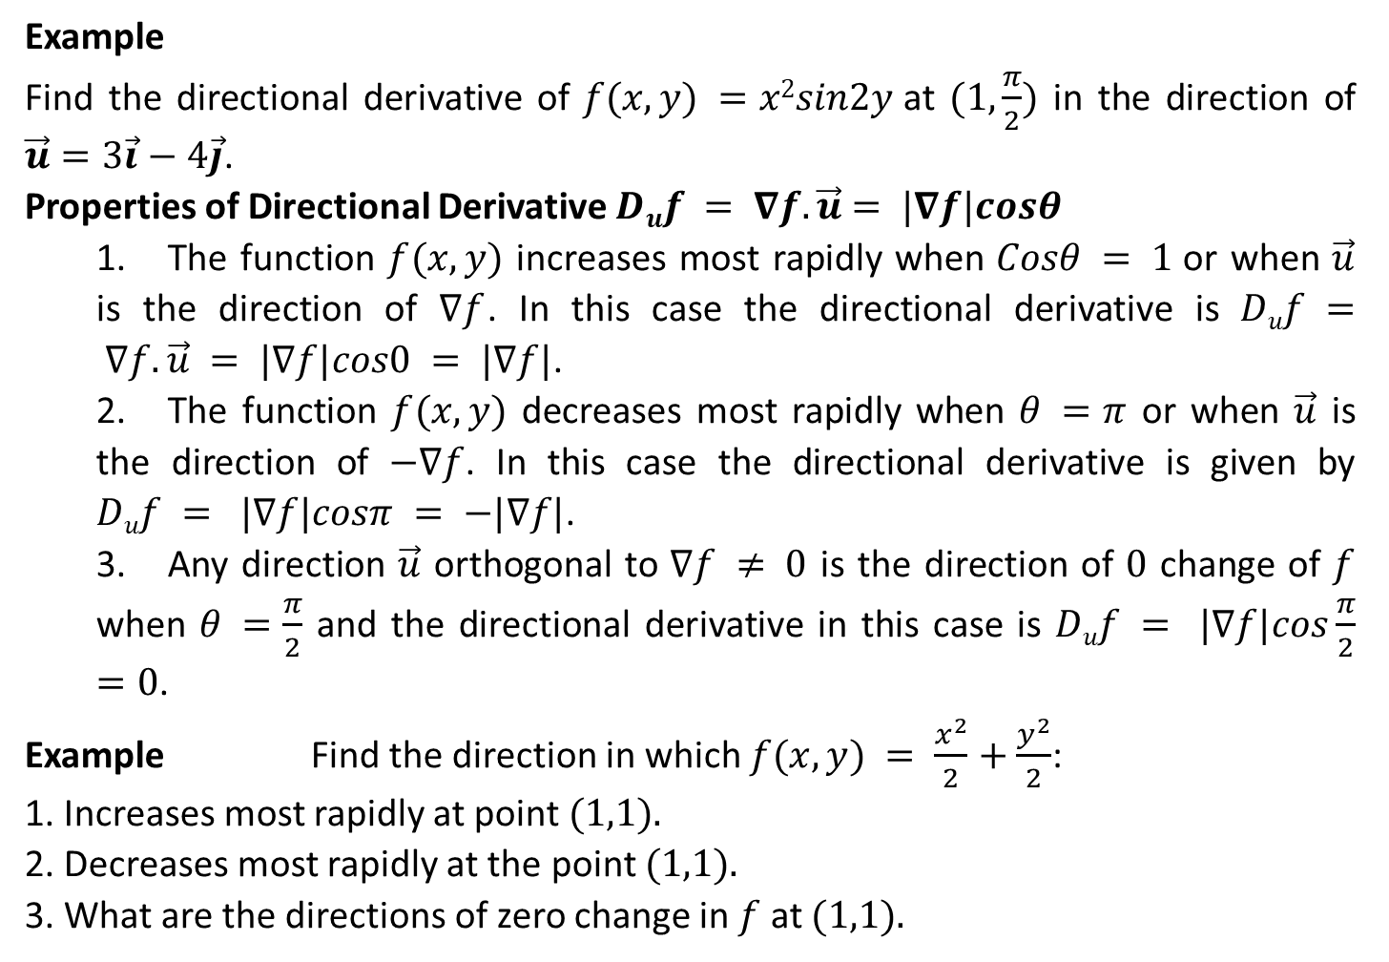
Example
Find the directional derivative of $f(x,y) =x2sin2y$at $(1,\frac{π}{2})$ in the direction of $\vec{u}=3\vec{i}−4\vec{j}$.
Properties of Directional Derivative $Duf = ∇f.\vec{u}$ $= |∇f|cosθ$
1. The function $f(x,y)$ increases most rapidly when $Cosθ = 1$or when $\vec{u}$ is the direction of $∇f$. In this case the directional derivative is $Duf = ∇f.\vec{u} = |∇f|cos0 = |∇f|$.
2. The function $f(x,y)$ decreases most rapidly when $θ =π$ or when $\vec{u}$ is the direction of $−∇f$. In this case the directional derivative is given by $Duf = |∇f|cosπ = −|∇f|$.
3. Any direction $\vec{u}$ orthogonal to $∇f ≠ 0$ is the direction of $0$ change of $f$ when $θ =\frac{π}{2}$ and the directional derivative in this case is $Duf = |∇f|cos\frac{π}{2}$ $=0$.
Example Find the direction in which $f(x,y) = \frac{x^{2}}{2}$ $+$ $\frac{y^{2}}{2}$:
1. Increases most rapidly at point $(1,1).$
2. Decreases most rapidly at the point $(1,1).$
3. What are the directions of zero change in $f$ at $(1,1).$

Slide 20
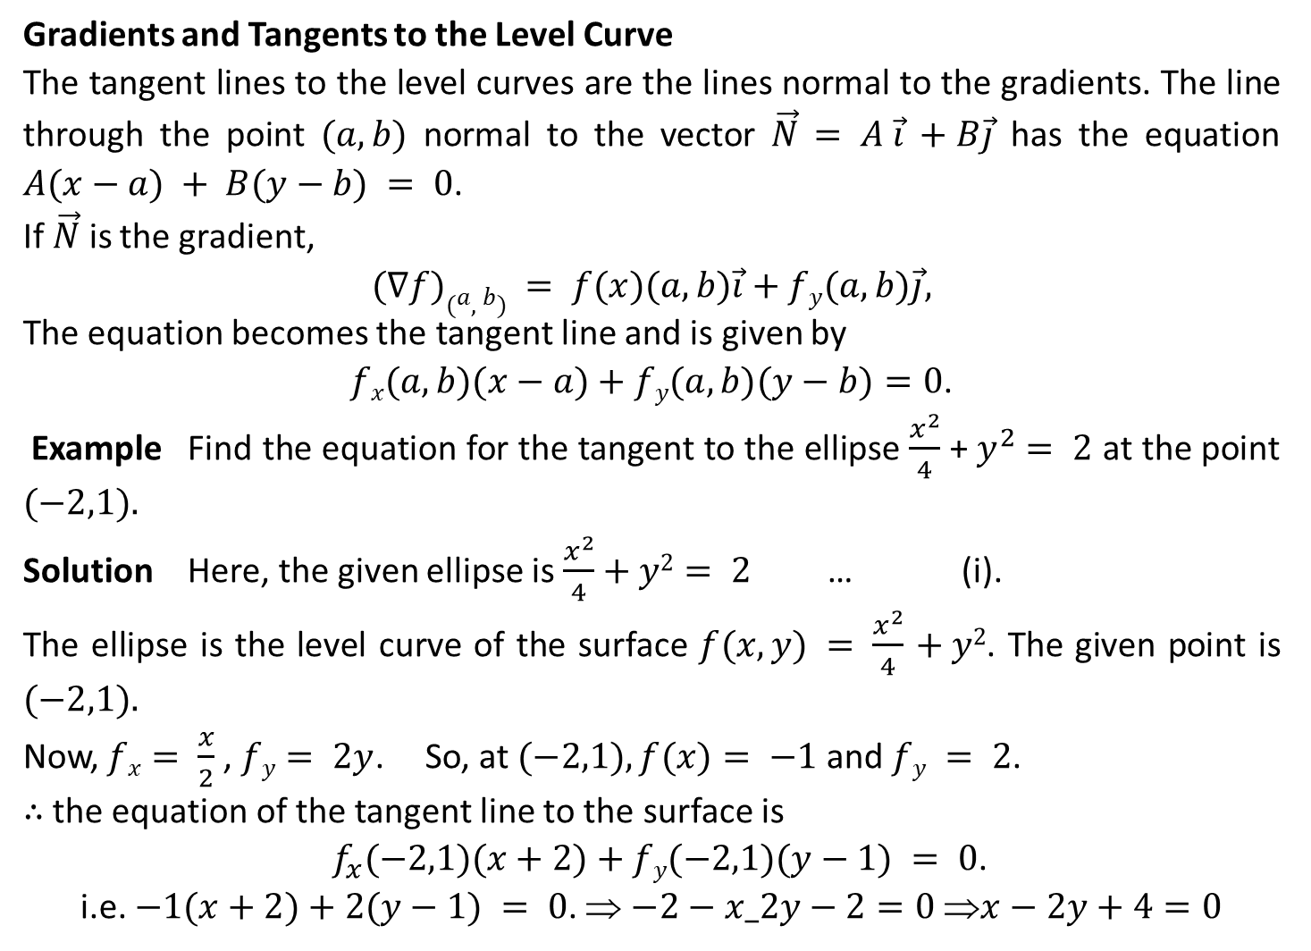
Gradients and Tangents to the Level Curve
The tangent lines to the level curves are the lines normal to the gradients. The line through the point $(a,b)$ normal to the vector $\vec{N}$ $= A \vec{i}$ $+ B\vec{j}$ has the equation $A(x−a) + B(y−b) = 0$.
If $\vec{N}$ is the gradient,
$(∇f)(a,b) = f(x)(a,b)\vec{i}$ $+ fy(a,b)\vec{j},$
The equation becomes the tangent line and is given by
$fx(a,b)(x−a)+fy(a,b)(y−b)=0$.
Example Find the equation for the tangent to the ellipse $\frac{x^{2}}{4}$ + $y^{2}$ $= 2$ at the point $(−2,1).$
Solution Here, the given ellipse is $\frac{x^{2}}{4}$ $+ y2= 2$ … (i).
The ellipse is the level curve of the surface $f(x,y) = \frac{x^{2}}{4}$ $+ y2$. The given point is $(−2,1).$
Now, $fx­= \frac{x}{2}$ , $fy= 2y$. So, at $(−2,1), f(x)= −1$ and $fy = 2$.
∴ the equation of the tangent line to the surface is
$f_{x}(−2,1)(x+2)+fy(−2,1)(y−1) = 0$.
i.e. $−1(x+2)+2(y−1) = 0$. ⇒ $−2−x_2y−2=0 x−2y+4=0$

Slide 21
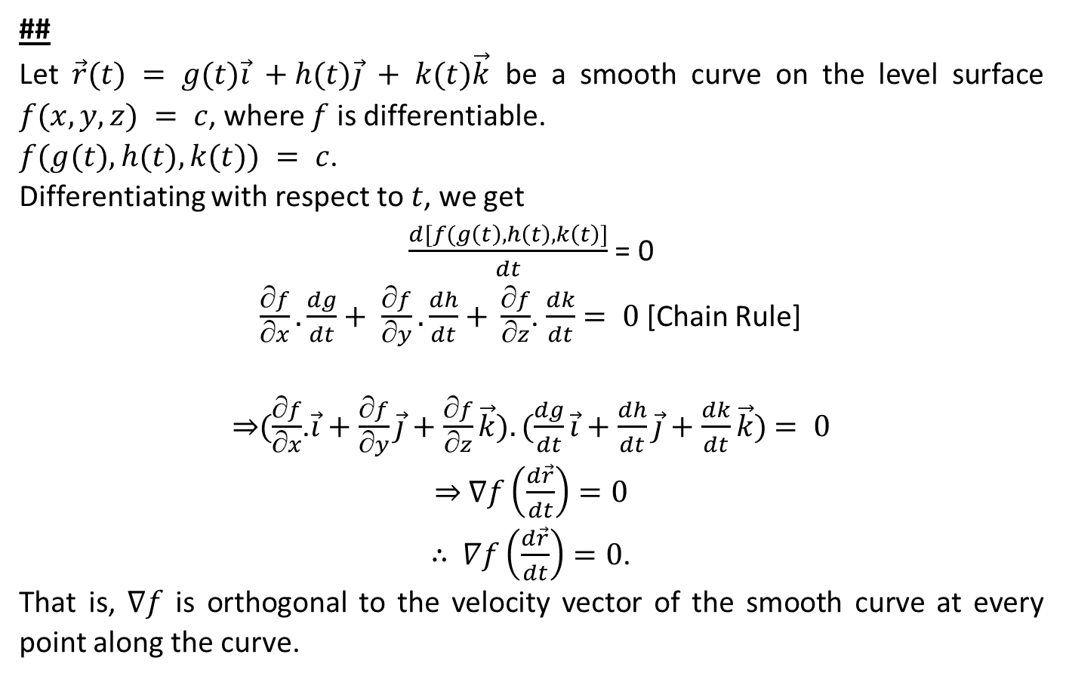
##
Let $\vec{r}(t) = g(t)\vec{i}$ $+ h(t)\vec{j} + k(t)\vec{k}$ be a smooth curve on the level surface $f(x,y,z) = c$, where $f$ is differentiable.
$f(g(t), h(t), k(t)) = c$.
Differentiating with respect to $t$, we get
$\frac{d[f(g\left(t\right),h\left(t\right),k\left(t\right)]}{dt}$ = 0
$\frac{∂f}{∂x}. \frac{dg}{dt}+ \frac{∂f}{∂y}.\frac{dh}{dt}$ $+ \frac{∂f}{∂z}$. $\frac{dk}{dt}$ $= 0$[Chain Rule]
⇒$(\frac{∂f}{∂x}$.$\vec{i}+\frac{∂f}{∂y}\vec{j}$ $+$ $\frac{∂f}{∂z}\vec{k}).(\frac{dg}{dt}\vec{i}$ $+$ $\frac{dh}{dt}\vec{j}$ $+$ $\frac{dk}{dt}\vec{k})$ $= 0$
⇒ $∇f\left(\frac{d\vec{r}}{dt}\right)=0$
∴ $∇f\left(\frac{d\vec{r}}{dt}\right)=0$.
That is, $∇f$ is orthogonal to the velocity vector of the smooth curve at every point along the curve.

Slide 22
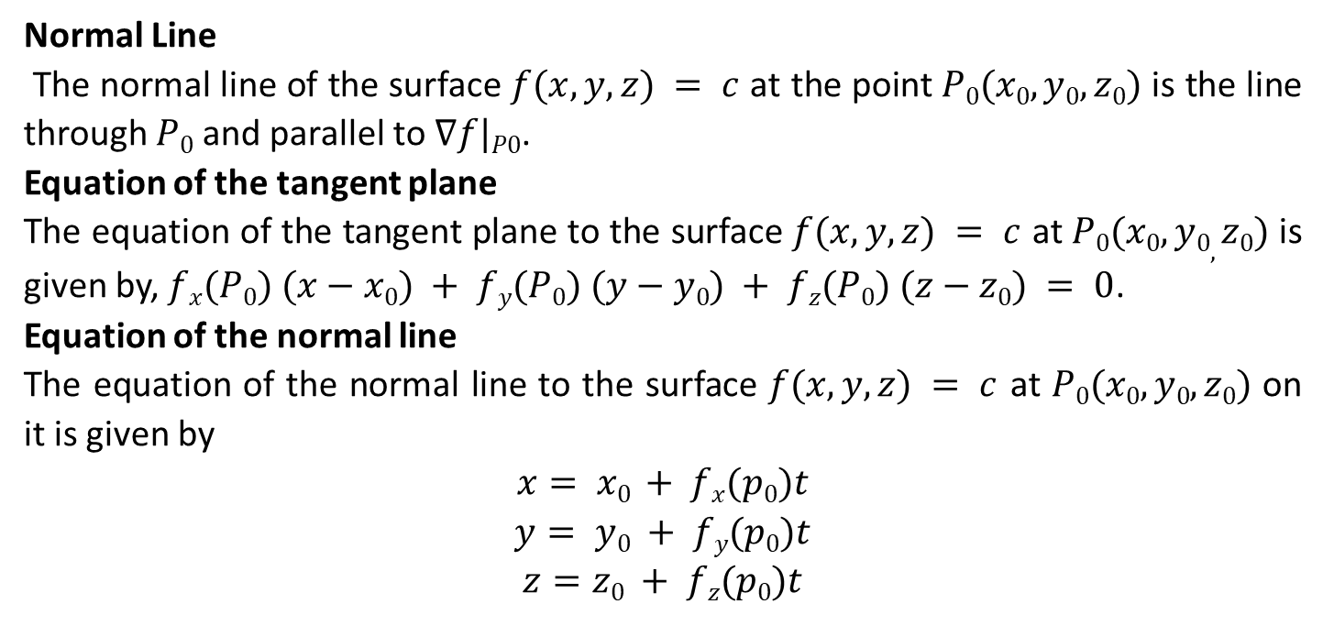
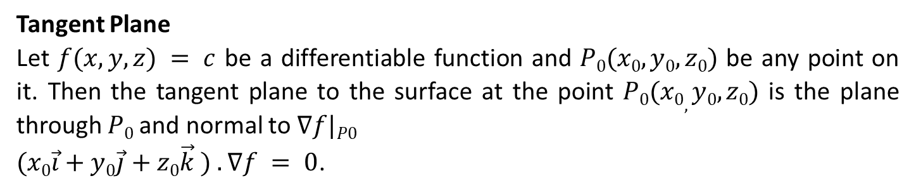
Tangent Plane
Let $f(x,y,z) = c$ be a differentiable function and $P0(x0,y0,z0)$ be any point on it. Then the tangent plane to the surface at the point $P0(x0,y0,z0)$ is the plane through $P0$and normal to $∇f|P0$
$(x0\vec{i}$ $+ y0\vec{j}$ $+ z­0\vec{k}$ $) . ∇f = 0$.
Normal Line
The normal line of the surface $f(x,y,z) = c$ at the point $P0(x0,y0,z0)$ is the line through $P0$ and parallel to $∇f|P0$.
Equation of the tangent plane
The equation of the tangent plane to the surface $f(x,y,z) = c$ at $P0(x0,y0,z0)$ is given by, $fx(P0) (x−x0) + fy(P0) (y−y0) + fz(P0) (z−z­0) = 0$.
Equation of the normal line
The equation of the normal line to the surface $f(x,y,z) = c$ at $P0(x0,y0,z0)$ on it is given by
$$x= x0 + fx(p0)t$$
$$y= y0 + fy(p0)t$$
$$z=z0 + fz(p0)t$$

Slide 23
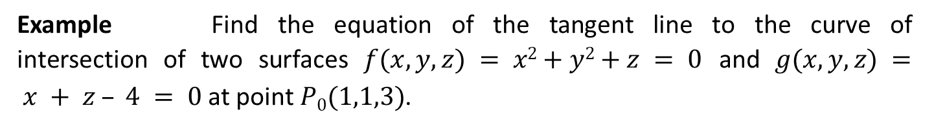
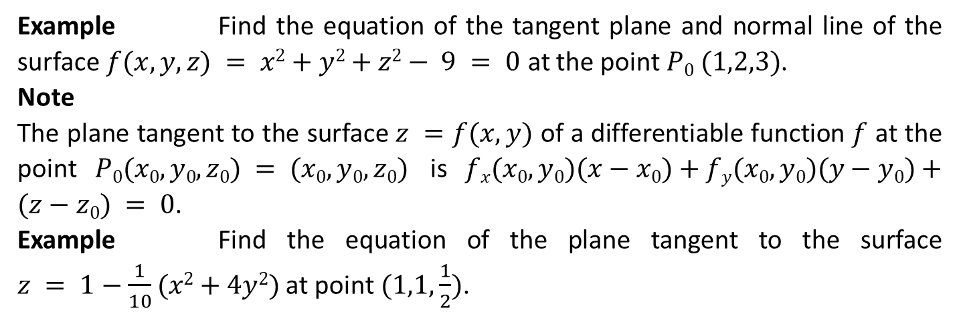
Example Find the equation of the tangent plane and normal line of the surface $f(x,y,z) = x2+y2+z2− 9 = 0$ at the point $P0 (1,2,3)$.
Note
The plane tangent to the surface $z =f(x,y)$ of a differentiable function $f$ at the point $P0(x0,y0,z0) = (x0,y0,z0)$ is $fx(x0,y0)(x−x0)+fy(x0,y0)(y−y0)+(z−z0) = 0$.
Example Find the equation of the plane tangent to the surface $z = 1−\frac{1}{10}(x2+4y2)$ at point $(1,1,\frac{1}{2})$.
Example Find the equation of the tangent line to the curve of intersection of two surfaces $f(x,y,z) = x2+y2+z = 0$ and $g(x,y,z) = x + z – 4 = 0$ at point $P0(1,1,3)$.

Slide 24
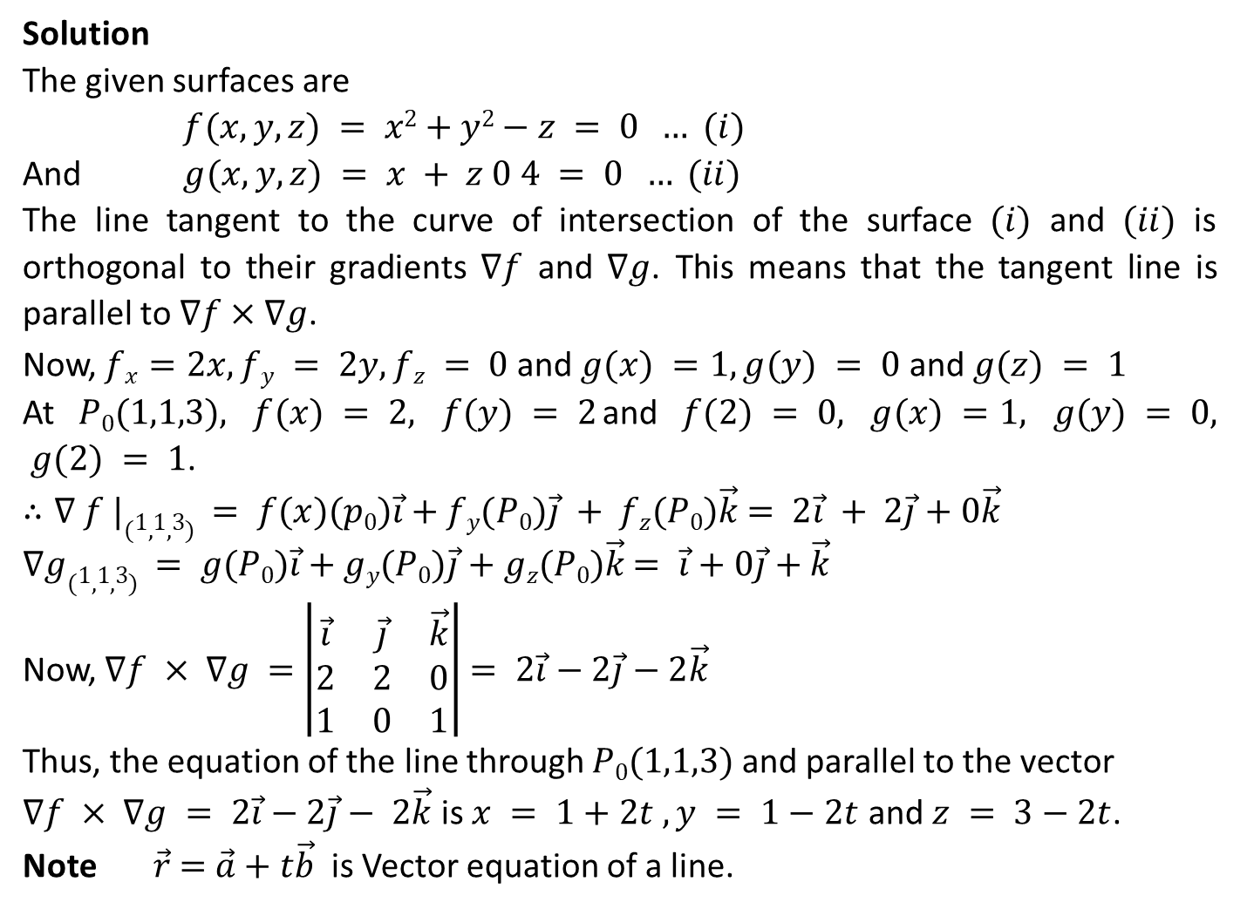
Solution
The given surfaces are
$f(x,y,z) = x2+y2−z = 0 … (i)$
And $g(x,y,z) = x + z 0 4 = 0 … (ii)$
The line tangent to the curve of intersection of the surface $(i)$ and $(ii)$ is orthogonal to their gradients $∇f$ and $∇g$. This means that the tangent line is parallel to $∇f×∇g$.
Now, $f­x=2x, fy = 2y, fz = 0$ and $g(x) =1, g(y) = 0$ and $g(z) = 1$
At $P0(1,1,3), f(x) = 2, f(y) = 2$and $f(2) = 0, g(x) =1, g(y) = 0, g(2) = 1$.
$∴∇ f |(1,1,3) = f(x)(p0)\vec{i}$ $+ fy(P0)\vec{j} + fz(P0)\vec{k}$ $= 2\vec{i} + 2\vec{j}$ $+ 0\vec{k}$
$∇g(1,1,3) = g(P0)\vec{i}$ $+ gy(P0)\vec{j}$ $+ gz(P0)\vec{k}$ $= \vec{i}$ $+ 0\vec{j}$ $+ \vec{k}$
Now, $∇f × ∇g =$ $\left|\begin{matrix}\vec{i} & \vec{j} & \vec{k} \\ 2 & 2 & 0 \\ 1 & 0 & 1\end{matrix}\right|$ $= 2\vec{i}$ $− 2\vec{j}$ $− 2\vec{k}$
Thus, the equation of the line through $P0(1,1,3)$ and parallel to the vector
$∇f × ∇g = 2\vec{i}$ $− 2\vec{j}− 2\vec{k}$ is $x = 1+2t , y = 1−2t$ and $z = 3−2t$.
Note $\vec{r}$ $=$ $\vec{a}$ $+ t\vec{b}$ is Vector equation of a line.

Slide 25
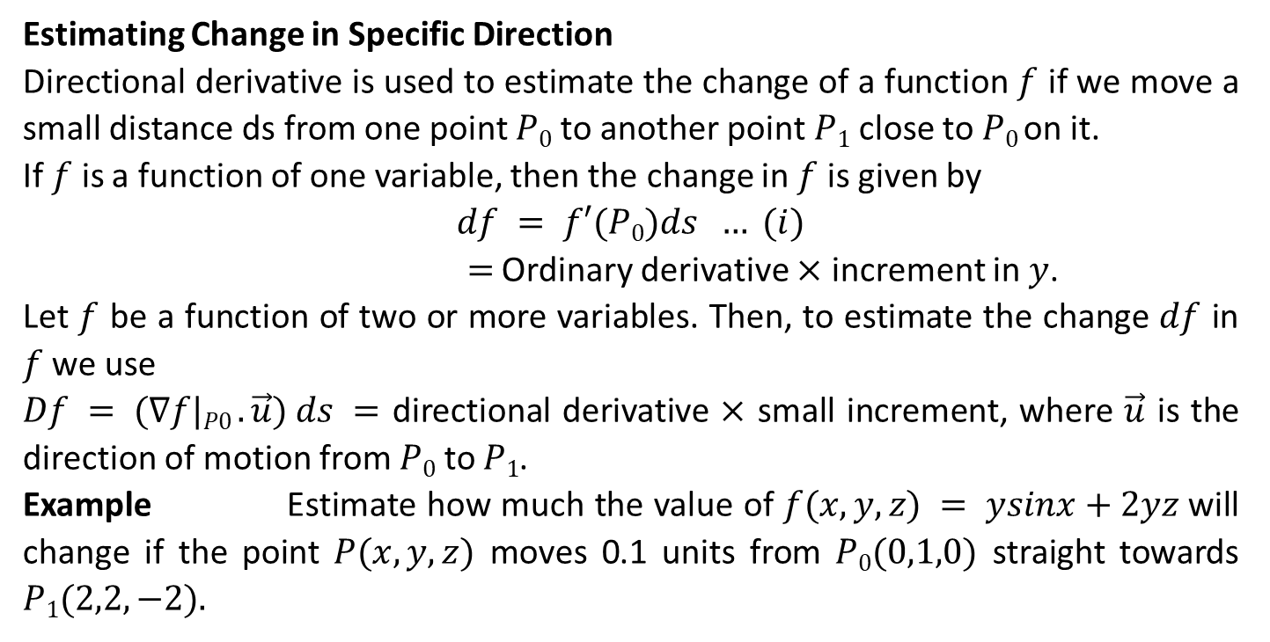
Estimating Change in Specific Direction
Directional derivative is used to estimate the change of a function $f$ if we move a small distance ds from one point $P0$ to another point $P1$ close to $P0$ on it.
If $f$ is a function of one variable, then the change in $f$ is given by
$$df = f′(P0)ds … (i)$$
$=$ Ordinary derivative $×$ increment in $y$.
Let $f$ be a function of two or more variables. Then, to estimate the change $df$ in $f$ we use
$Df = (∇f|P0 . \vec{u}) ds =$ directional derivative $×$ small increment, where $\vec{u}$ is the direction of motion from $P0$ to $P1$.
Example Estimate how much the value of $f(x,y,z) = ysinx+2yz$will change if the point $P(x,y,z)$ moves 0.1 units from $P0(0,1,0)$ straight towards $P1(2,2,−2).$

Slide 26
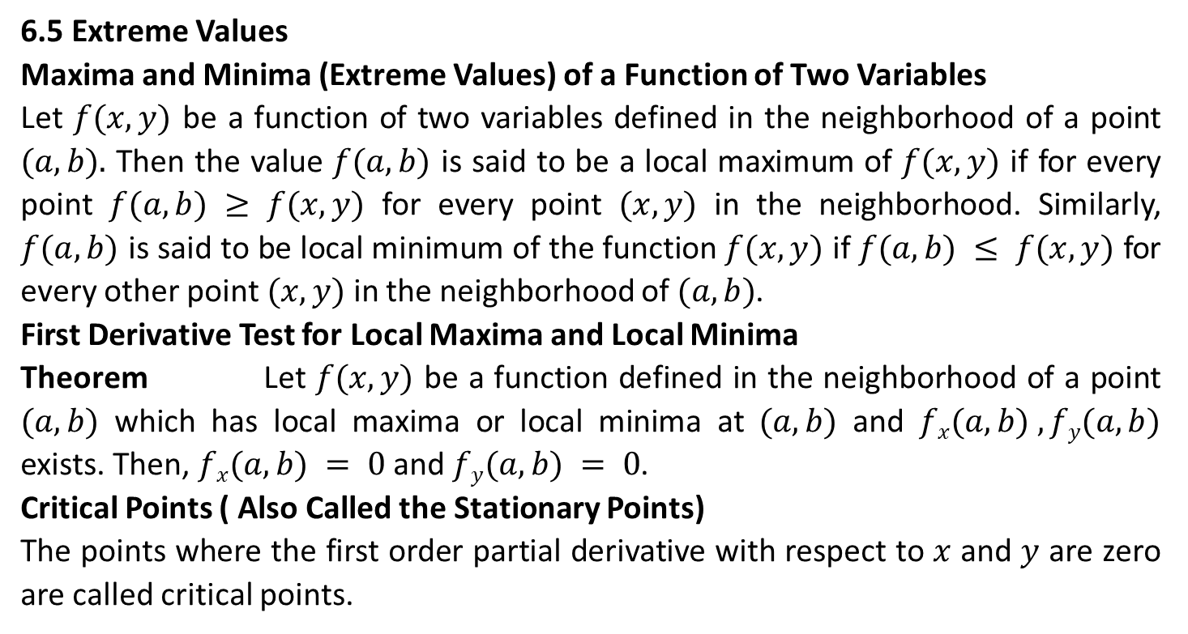
6.5 Extreme Values
Maxima and Minima (Extreme Values) of a Function of Two Variables
Let $f(x,y)$ be a function of two variables defined in the neighborhood of a point $(a,b).$ Then the value $f(a,b)$ is said to be a local maximum of $f(x,y)$ if for every point $f(a,b) ≥ f(x,y)$ for every point $(x,y)$ in the neighborhood. Similarly, $f(a,b)$ is said to be local minimum of the function $f(x,y)$ if $f(a,b) ≤ f(x,y)$ for every other point $(x,y)$ in the neighborhood of $(a,b)$.
First Derivative Test for Local Maxima and Local Minima
Theorem Let $f(x,y)$ be a function defined in the neighborhood of a point $(a,b)$ which has local maxima or local minima at $(a,b)$ and $fx(a,b) , fy(a,b)$ exists. Then, $fx(a,b) = 0$ and $fy(a,b) = 0$.
Critical Points ( Also Called the Stationary Points)
The points where the first order partial derivative with respect to $x$ and $y$ are zero are called critical points.

Slide 27
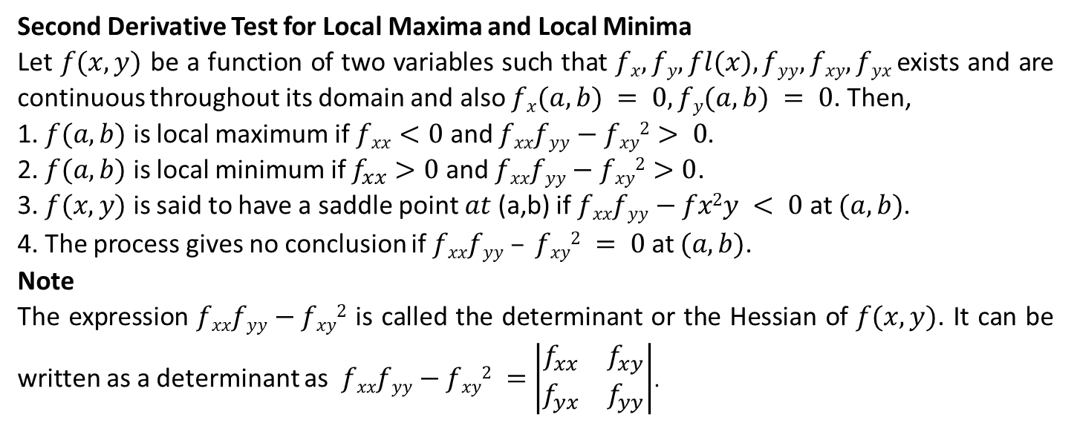
Second Derivative Test for Local Maxima and Local Minima
Let $f(x,y)$ be a function of two variables such that $fx, fy, fl(x), fyy, fxy, fyx$ exists and are continuous throughout its domain and also $fx(a,b) = 0, fy(a,b) = 0$. Then,
1. $f(a,b)$ is local maximum if $fxx<0$ and $fxxfyy−fxy2> 0$.
2. $f(a,b)$ is local minimum if $f_{xx}>0$ and $fxxfyy−fxy2>0$.
3. $f(x,y)$ is said to have a saddle point $at$(a,b) if $fxxfyy−fx2y < 0$ at $(a,b)$.
4. The process gives no conclusion if $fxxfyy – fxy2 = 0$ at $(a,b)$.
Note
The expression $fxxfyy−fxy2$ is called the determinant or the Hessian of $f(x,y)$. It can be written as a determinant as $fxxfyy−fxy2 =$ $\left|\begin{matrix}f_{xx} & f_{xy} \\ f_{yx} & f_{yy}\end{matrix}\right|$.

Slide 28
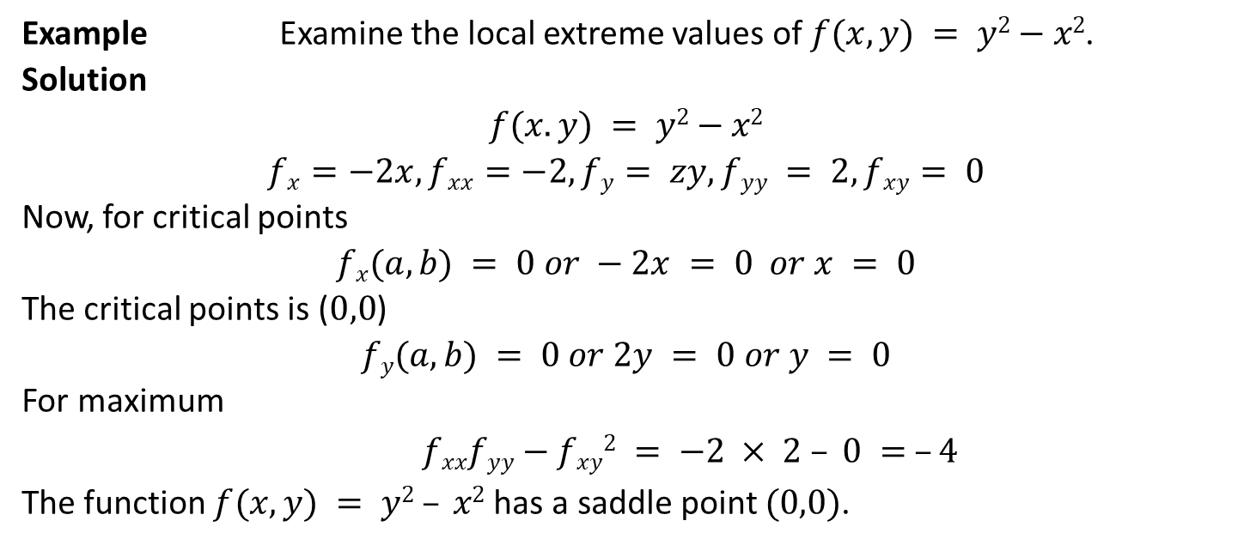
Example Examine the local extreme values of $f(x,y) = y2−x2$.
Solution
$$f(x.y) = y2−x2$$
$$fx=−2x, fxx=−2, fy= zy, fyy = 2, fxy= 0$$
Now, for critical points
$$fx(a,b) = 0 or −2x = 0 or x = 0$$
The critical points is ($0,0$)
$$fy(a,b) = 0 or 2y = 0 or y = 0$$
For maximum
$fxxfyy−fxy2 = −2 × 2 – 0 = –4$
The function $f(x,y) = y2 – x2$has a saddle point $(0,0)$.

Slide 29
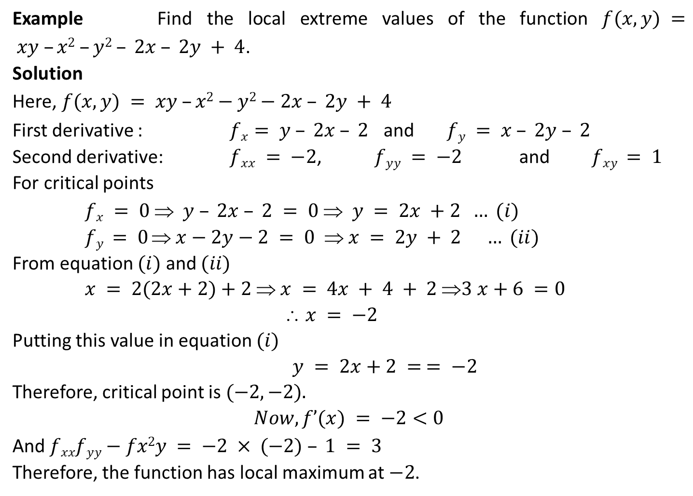
Example Find the local extreme values of the function $f(x,y) = xy –x2 –y2 – 2x – 2y + 4$.
Solution
Here, $f(x,y) = xy –x2−y2−2x – 2y + 4$
First derivative : $fx= y – 2x – 2$ and $fy = x – 2y – 2$
Second derivative: $fxx = −2$, $fyy = −2$ and $fxy = 1$
For critical points
$fx = 0  y – 2x – 2 = 0  y = 2x +2 … (i)$
$fy = 0  x−2y−2 = 0  x = 2y + 2 … (ii)$
From equation $(i)$ and $(ii)$
$x = 2(2x+2)+2  x = 4x + 4 + 2 3 x+6 =0$
$$ x = −2$$
Putting this value in equation $(i)$
$y = 2x+2 = = −2$
Therefore, critical point is $(−2,−2).$
$$Now,f’(x) = −2<0$$
And $fxxfyy−fx2y = −2 × (−2) – 1 = 3$
Therefore, the function has local maximum at $−2$.

Slide 30
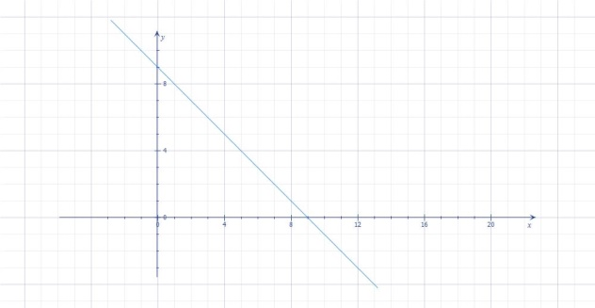
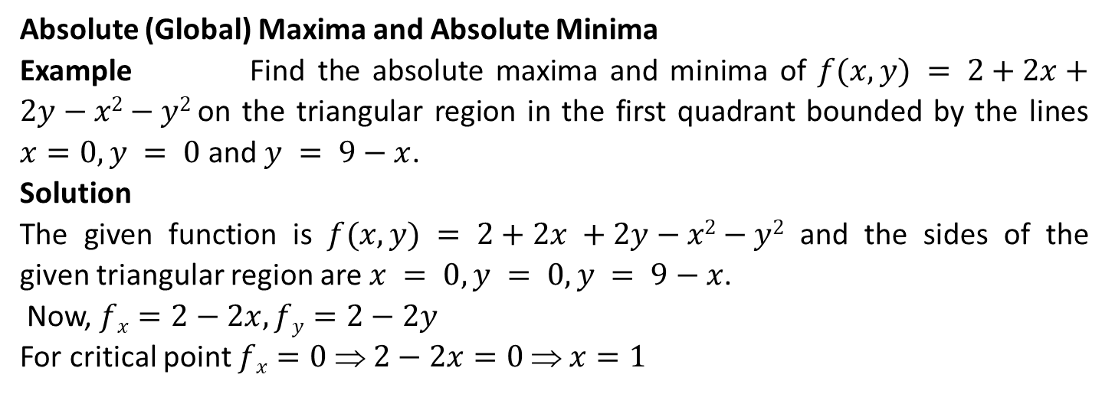
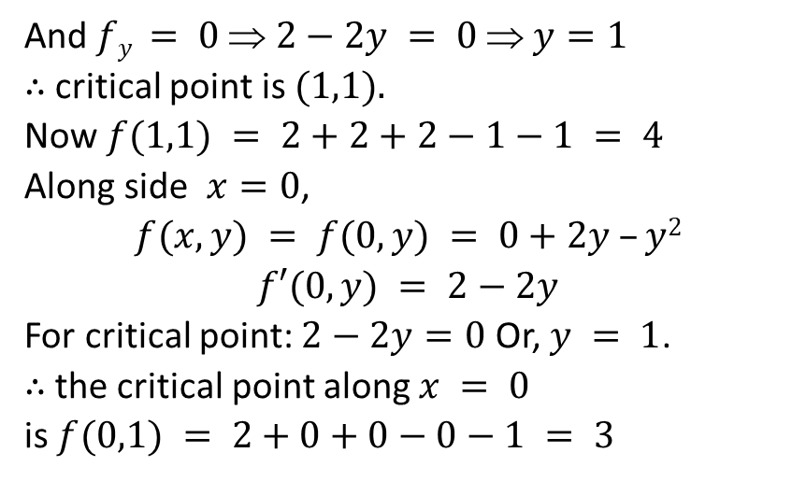
Absolute (Global) Maxima and Absolute Minima
Example Find the absolute maxima and minima of $f(x,y) = 2+2x+2y−x2−y2$on the triangular region in the first quadrant bounded by the lines $x=0, y = 0$and $y = 9−x$.
Solution
The given function is $f(x,y) = 2+2x +2y−x2−y2$ and the sides of the given triangular region are $x = 0, y = 0, y = 9−x$.
Now, $fx=2−2x, fy=2−2y$
For critical point $fx=0  2−2x=0  x=1$
And $fy = 0  2−2y = 0  y=1$
∴ critical point is $(1,1).$
Now $f(1,1) = 2+2+2−1−1 = 4$
Along side $x=0$,
$$f(x,y) = f(0,y) = 0+2y –y2$$
$$f′(0,y) = 2−2y$$
For critical point: $2−2y=0$ Or, $y = 1$.
∴ the critical point along $x = 0$
is $f(0,1) = 2+0+0−0−1 = 3$

Slide 31
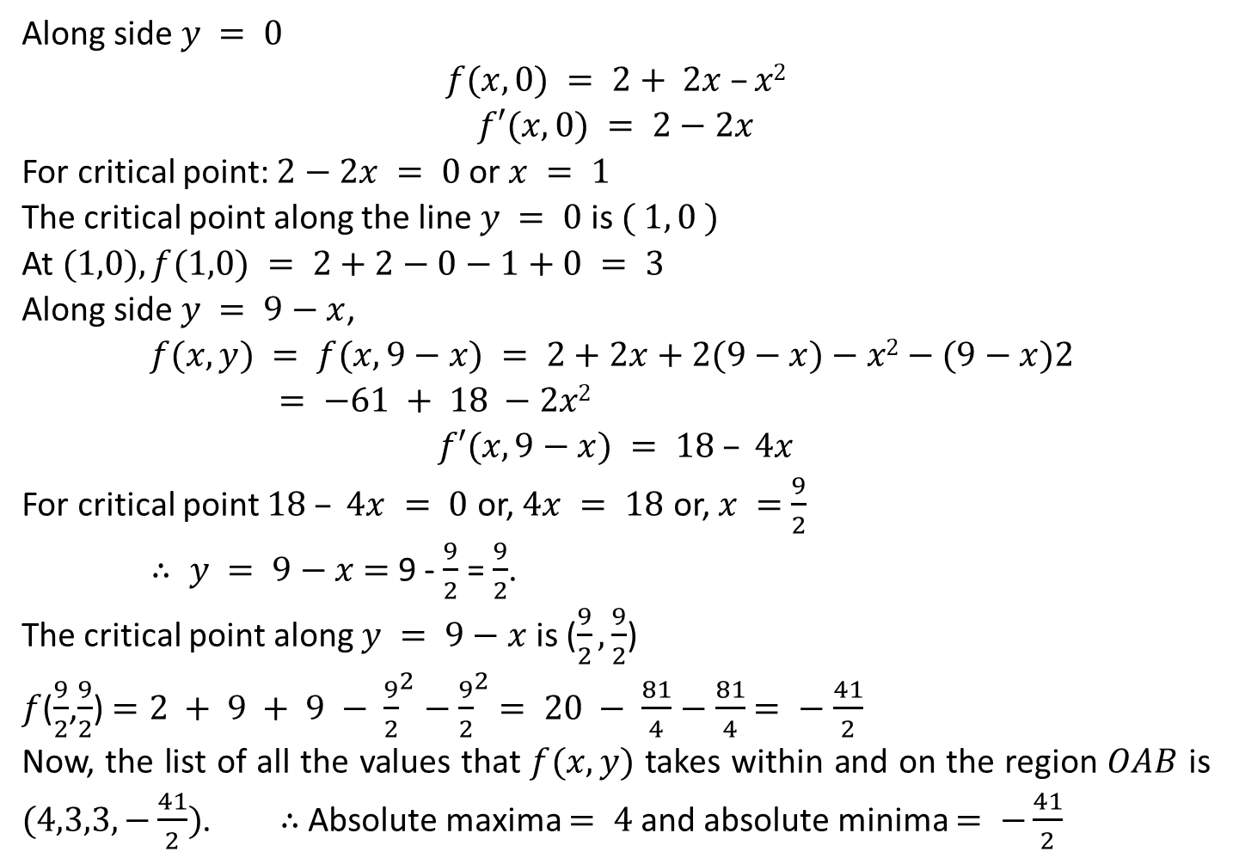
Along side $y = 0$
$$f(x,0) = 2+ 2x –x2$$
$$f′(x,0) = 2−2x$$
For critical point: $2−2x = 0$or $x = 1$
The critical point along the line $y = 0$is $( 1, 0 )$
At $(1,0), f(1,0) = 2+2−0−1+0 = 3$
Along side $y = 9−x$,
$$f(x,y) = f(x,9−x) = 2+2x+2(9−x)−x2−(9−x)2 = −61 + 18 −2x2$$
$$f′(x,9−x) = 18 – 4x$$
For critical point $18 – 4x = 0$ or, $4x = 18$ or, $x =$ $\frac{9}{2}$
$∴ y = 9−x$ $=$ 9 - $\frac{9}{2}$ = $\frac{9}{2}$.
The critical point along $y = 9−x$ is ($\frac{9}{2},\frac{9}{2}$)
$f$($\frac{9}{2}$,$\frac{9}{2}$) $=2 + 9 + 9 − {\frac{9}{2}}^{2}−{\frac{9}{2}}^{2}$ $= 20 − \frac{81}{4}$ $−$ $\frac{81}{4}$ $= −$ $\frac{41}{2}$
Now, the list of all the values that $f(x,y)$ takes within and on the region $OAB$ is $(4,3,3,−\frac{41}{2})$. ∴ Absolute maxima $= 4$and absolute minima $= −\frac{41}{2}$

Slide 32
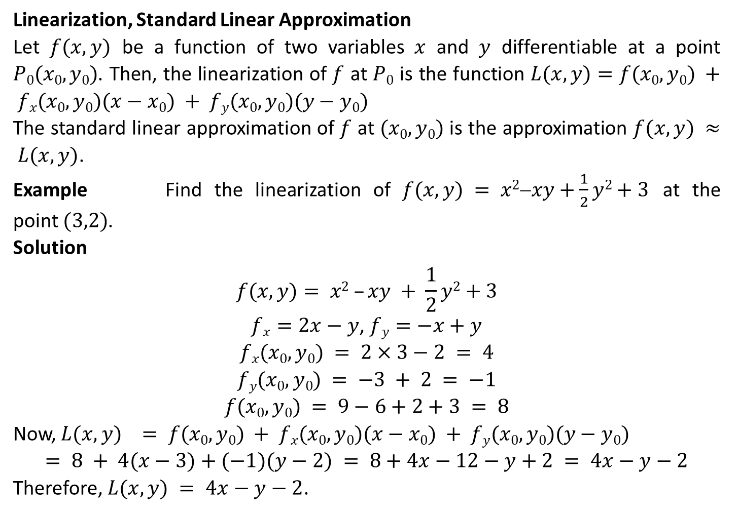
Linearization, Standard Linear Approximation
Let $f(x,y)$ be a function of two variables $x$ and $y$ differentiable at a point $P0(x0,y0)$. Then, the linearization of $f$ at $P0$ is the function $L(x,y)=f(x0,y0) + fx(x0,y0)(x−x0) + fy(x0,y0)(y−y0)$
The standard linear approximation of $f$ at $(x0,y0)$ is the approximation $f(x,y) ≈ L(x,y)$.
Example Find the linearization of $f(x,y) = x2−xy+\frac{1}{2}y2+3$ at the point $(3,2)$.
Solution
$$f(x,y)= x2 –xy + \frac{1}{2}y2+3$$
$fx=2x−y$, $fy=−x+y$
$$fx(x0,y0) = 2×3−2 = 4$$
$$fy(x0,y0) = −3 + 2 = −1$$
$$f(x0,y0) = 9−6+2+3 = 8$$
Now, $L(x,y) = f(x0,y0) + fx(x0,y0)(x−x0) + fy(x0,y0)(y−y0)$
$$= 8 + 4(x−3)+(−1)(y−2) = 8+4x−12−y+2 = 4x−y−2$$
Therefore, $L(x,y) = 4x−y−2$.

Slide 33
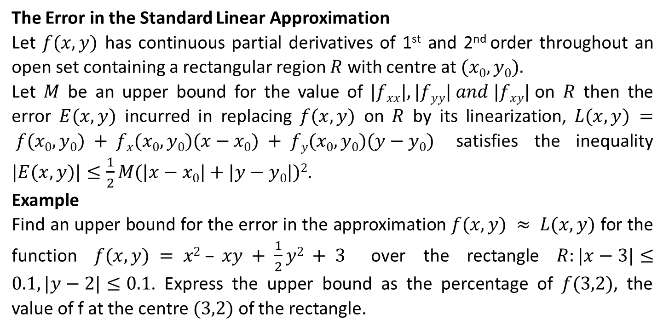
The Error in the Standard Linear Approximation
Let $f(x,y)$ has continuous partial derivatives of 1st and 2nd order throughout an open set containing a rectangular region $R$ with centre at $(x0,y0).$
Let $M$ be an upper bound for the value of $|fxx|, |fyy| and |fxy|$on $R$ then the error $E(x,y)$ incurred in replacing $f(x,y)$ on $R$ by its linearization, $L(x,y) = f(x0,y0) + fx(x0,y0)(x−x0) + fy(x0,y0)(y−y0)$ satisfies the inequality $|E(x,y)|≤\frac{1}{2}M(|x−x0|+|y−y0|)2$.
Example
Find an upper bound for the error in the approximation $f(x,y) ≈ L(x,y)$ for the function $f(x,y) = x2 – xy + \frac{1}{2}y2 + 3$ over the rectangle $R:|x−3|≤0.1, |y−2|≤0.1$. Express the upper bound as the percentage of $f(3,2)$, the value of f at the centre $(3,2)$ of the rectangle.

Slide 34
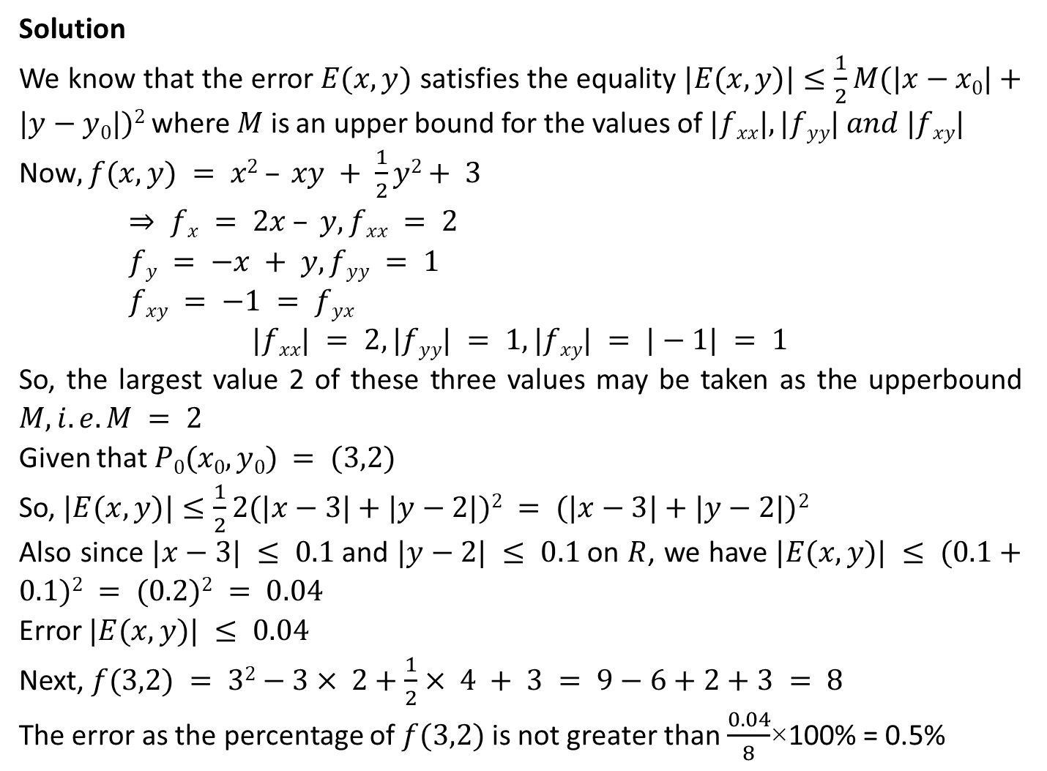
Solution
We know that the error $E(x,y)$ satisfies the equality $|E(x,y)|≤\frac{1}{2}M(|x−x0|+|y−y0|)2$where $M$ is an upper bound for the values of $|fxx|, |fyy| and |fxy|$
Now$, f(x,y) = x2 – xy + \frac{1}{2}y2+ 3$
$⇒ fx = 2x – y, fxx = 2$
$fy = −x + y, fyy = 1$
$fxy = −1 = fyx$
$$|fxx| = 2, |fyy| = 1, |fxy| = |−1| = 1$$
So, the largest value 2 of these three values may be taken as the upperbound $M, i.e. M = 2$
Given that $P0(x0,y0) = (3,2)$
So, $|E(x,y)|≤\frac{1}{2}2(|x−3|+|y−2|)2 = (|x−3|+|y−2|)2$
Also since $|x−3| ≤ 0.1$and $|y−2| ≤ 0.1$on $R$, we have $|E(x,y)| ≤ (0.1+0.1)2 = (0.2)2 = 0.04$
Error $|E(x,y)| ≤ 0.04$
Next, $f(3,2) = 32−3× 2+\frac{1}{2}× 4 + 3 = 9−6+2+3 = 8$
The error as the percentage of $f(3,2)$ is not greater than $\frac{0.04}{8}$×100% = 0.5%

Slide 35
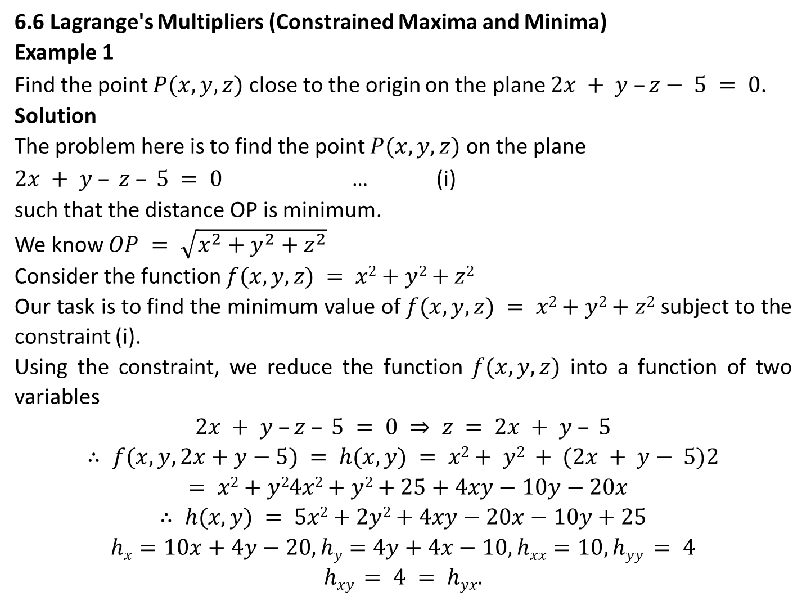
6.6 Lagrange's Multipliers (Constrained Maxima and Minima)
Example 1
Find the point $P(x,y,z)$ close to the origin on the plane $2x + y –z− 5 = 0$.
Solution
The problem here is to find the point $P(x,y,z)$ on the plane
$2x + y – z – 5 = 0$ … (i)
such that the distance OP is minimum.
We know $OP = \sqrt{x^{2}+y^{2}+z^{2}}$
Consider the function $f(x,y,z) = x2+y2+z2$
Our task is to find the minimum value of $f(x,y,z) = x2+y2+z2$ subject to the constraint (i).
Using the constraint, we reduce the function $f(x,y,z)$ into a function of two variables
$$2x + y –z – 5 = 0 ⇒ z = 2x + y – 5$$
$$∴ f(x,y,2x+y−5) = h(x,y) = x2+ y2 + (2x + y− 5)2$$
$= x2+y24x2+y2+25+4xy−10y−20x$
$$∴ h(x,y) = 5x2+2y2+4xy−20x−10y+25$$
$$hx=10x+4y−20, hy=4y+4x−10, hxx=10, hyy = 4$$
$$hxy = 4 = hyx.$$

Slide 36
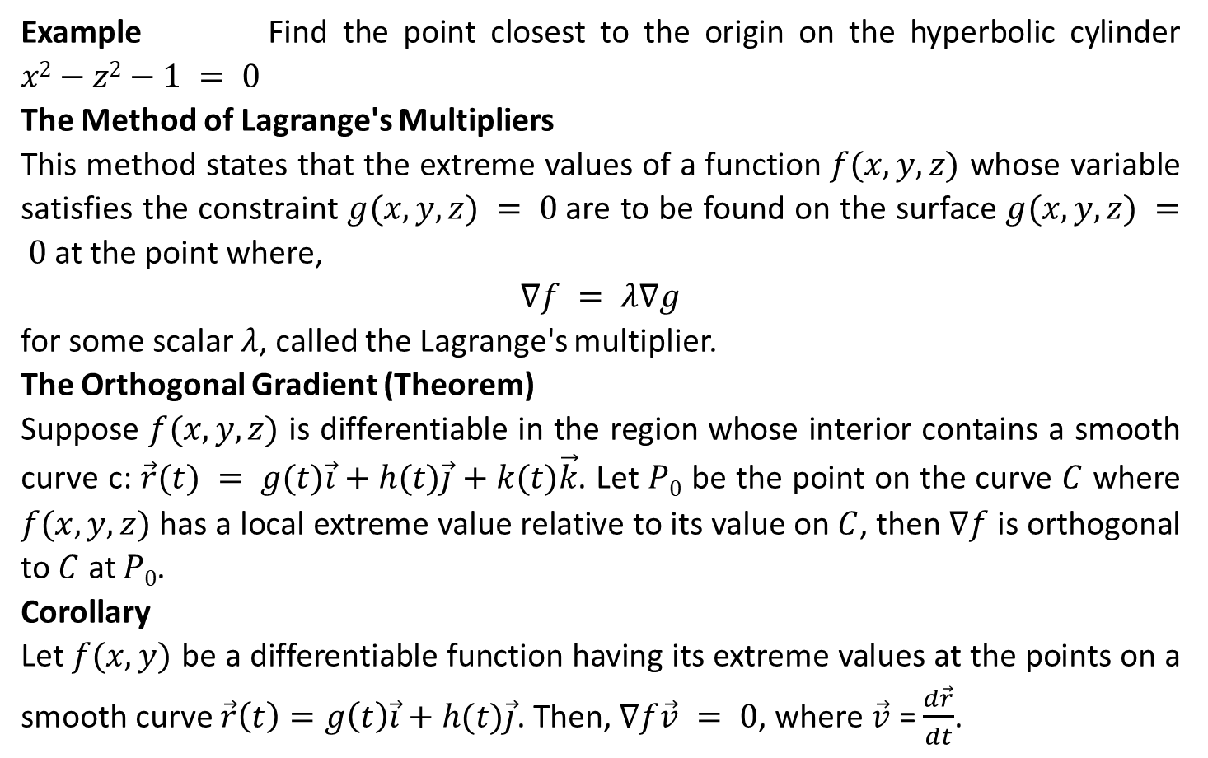
Example Find the point closest to the origin on the hyperbolic cylinder $x2−z2−1 = 0$
The Method of Lagrange's Multipliers
This method states that the extreme values of a function $f(x,y,z)$ whose variable satisfies the constraint $g(x,y,z) = 0$are to be found on the surface $g(x,y,z) = 0$at the point where,
$$∇f = λ∇g$$
for some scalar $λ$, called the Lagrange's multiplier.
The Orthogonal Gradient (Theorem)
Suppose $f(x,y,z)$ is differentiable in the region whose interior contains a smooth curve c: $\vec{r}(t) = g(t)\vec{i}$ $+ h(t)\vec{j}$ $+ k(t)\vec{k}$. Let $P0$ be the point on the curve $C$ where $f(x,y,z)$ has a local extreme value relative to its value on $C$, then $∇f$ is orthogonal to $C$ at $P0$.
Corollary
Let $f(x,y)$ be a differentiable function having its extreme values at the points on a smooth curve $\vec{r}\left(t\right)=g\left(t\right)\vec{i}+h(t)\vec{j}$. Then, $∇f\vec{v} = 0$, where $\vec{v}$ = $\frac{d\vec{r}}{dt}$.

Slide 37
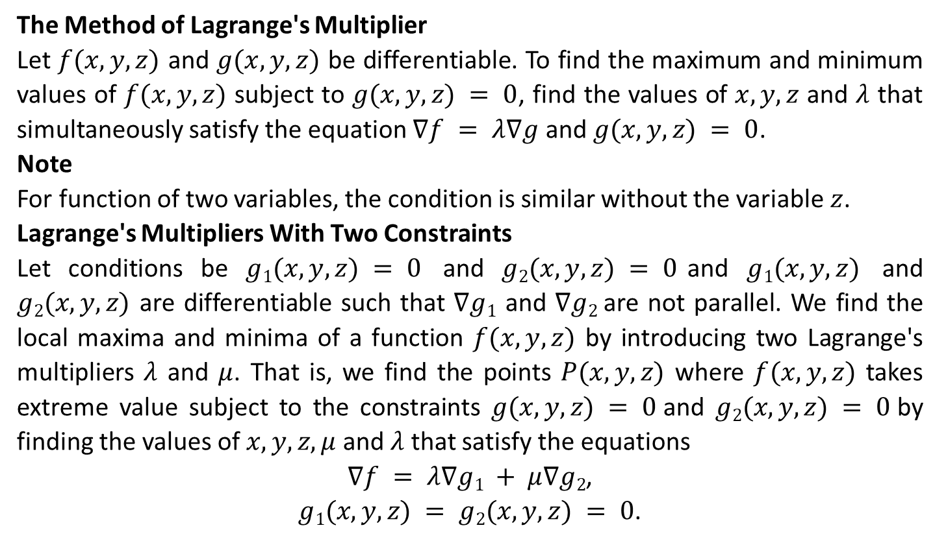
The Method of Lagrange's Multiplier
Let $f(x,y,z)$ and $g(x,y,z)$ be differentiable. To find the maximum and minimum values of $f(x,y,z)$ subject to $g(x,y,z) = 0$, find the values of $x, y, z$ and $λ$ that simultaneously satisfy the equation $∇f = λ∇g$ and $g(x,y,z) = 0$.
Note
For function of two variables, the condition is similar without the variable $z$.
Lagrange's Multipliers With Two Constraints
Let conditions be $g1(x,y,z) = 0$ and $g2(x,y,z) = 0$and $g1(x,y,z)$ and $g2(x,y,z)$ are differentiable such that $∇g1$ and $∇g2$are not parallel. We find the local maxima and minima of a function $f(x,y,z)$ by introducing two Lagrange's multipliers $λ$ and $μ$. That is, we find the points $P(x,y,z)$ where $f(x,y,z)$ takes extreme value subject to the constraints $g(x,y,z) = 0$and $g2(x,y,z) = 0$by finding the values of $x,y,z,μ$ and $λ$ that satisfy the equations
$∇f = λ∇g1 + μ∇g2$,
$g1(x,y,z) = g2(x,y,z) = 0$.

Slide 38
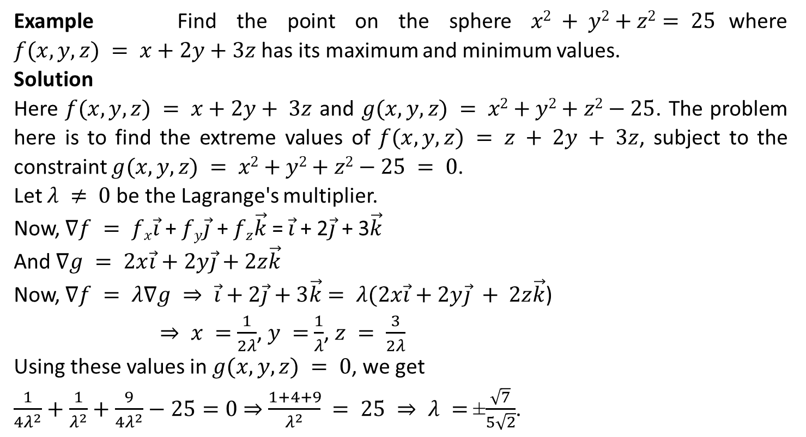
Example Find the point on the sphere $x2 + y2+z2= 25$where $f(x,y,z) = x+2y+3z$ has its maximum and minimum values.
Solution
Here $f(x,y,z) = x+2y+ 3z$ and $g(x,y,z) = x2+y2+z2−25$. The problem here is to find the extreme values of $f(x,y,z) = z + 2y + 3z$, subject to the constraint $g(x,y,z) = x2+y2+z2−25 = 0$.
Let $λ ≠ 0$be the Lagrange's multiplier.
Now, $∇f = fx\vec{i}$ + $fy\vec{j}$ + $fz\vec{k}$ = $\vec{i}$ + 2$\vec{j}$ + 3$\vec{k}$
And $∇g = 2x\vec{i}$ $+ 2y\vec{j}$ $+ 2z\vec{k}$
Now, $∇f = λ∇g ⇒ \vec{i}$ $+ 2\vec{j}$ $+ 3\vec{k}$ $= λ(2x\vec{i}$ $+ 2y\vec{j} + 2z\vec{k}$)
$⇒ x =$ $\frac{1}{2λ}$, $y =$ $\frac{1}{λ}$, $z = \frac{3}{2λ}$
Using these values in $g(x,y,z) = 0$, we get
$\frac{1}{4λ^{2}}+\frac{1}{λ^{2}}+\frac{9}{4λ^{2}}−25=0$ ⇒ $\frac{1+4+9}{λ^{2}} = 25 ⇒ λ =$±$\frac{\sqrt{7}}{5\sqrt{2}}$.

Slide 39
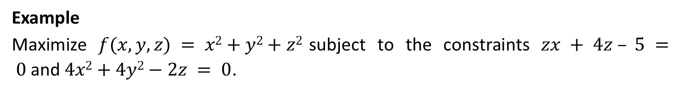
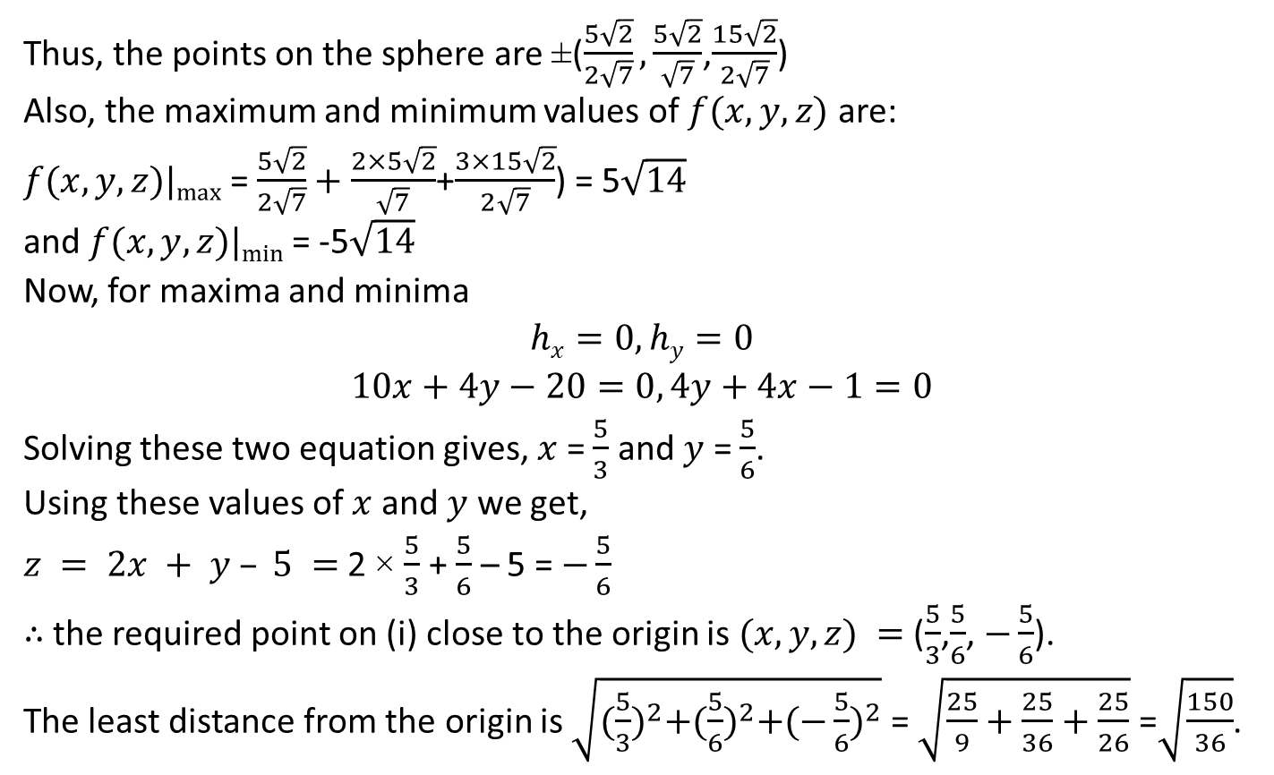
Thus, the points on the sphere are ±($\frac{5\sqrt{2}}{2\sqrt{7}},\frac{5\sqrt{2}}{\sqrt{7}}$,$\frac{15\sqrt{2}}{2\sqrt{7}}$)
Also, the maximum and minimum values of $f(x,y,z)$ are:
$f(x,y,z)|max⁡$= $\frac{5\sqrt{2}}{2\sqrt{7}}+\frac{2×5\sqrt{2}}{\sqrt{7}}$+$\frac{3×15\sqrt{2}}{2\sqrt{7}}$) = 5$\sqrt{14}$
and $f(x,y,z)|min⁡$= -5$\sqrt{14}$
Now, for maxima and minima
$$hx=0, hy=0$$
$$10x+4y−20=0, 4y+4x−1=0$$
Solving these two equation gives, $x$ = $\frac{5}{3}$ and $y$ = $\frac{5}{6}$.
Using these values of $x$ and $y$ we get,
$z = 2x + y – 5 =$2 × $\frac{5}{3}$ + $\frac{5}{6}$ – 5 = $−\frac{5}{6}$
∴ the required point on (i) close to the origin is $(x,y,z) =$($\frac{5}{3}$,$\frac{5}{6}$, $−\frac{5}{6}$).
The least distance from the origin is $\sqrt{{(\frac{5}{3})}^{2}+{(\frac{5}{6})}^{2}+{(−\frac{5}{6})}^{2}}$ = $\sqrt{\frac{25}{9}+\frac{25}{36}+\frac{25}{26}}$ =$\sqrt{\frac{150}{36}}$.
Example
Maximize $f(x,y,z) = x2+y2+z2$subject to the constraints $zx + 4z – 5 = 0$and $4x2+4y2−2z = 0$.

Slide 40
The End

